Slide 1

WAVE PTX ACCESSORIES
OVERVIEW
April, 2021

Slide 2





WAVE PTX ACCESSORY OVERVIEW
THE RIGHT FIT FOR EACH VERTICAL AND ROLE
Construction
Education
Hospitality
Transportation
Utilities
Remote Speaker Mics
Bluetooth Mics
Bluetooth PTT Button
Discrete Headset Mics
Bluetooth Mics
Bluetooth PTT Button
Discrete Headset Mics
Bluetooth Mics
Dispatch Accessories
Bluetooth PTT Button
Car Kits
Dispatch Accessories
Remote Speaker Mics
Bluetooth Mics
Intrinsically Safe

Slide 3
Motorola Solutions Accessories

Slide 4
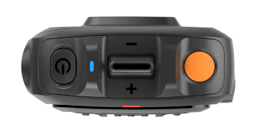
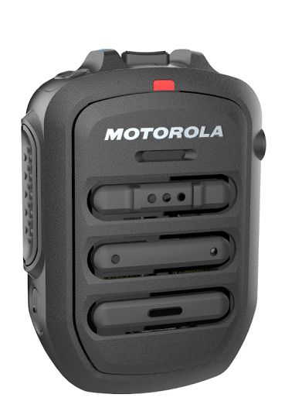


MOTOROLA SOLUTIONS ACCESSORIES
HANDSET
Power/MFB Button
Volume Toggle
40 hours talk-time MIN (5/5/90), 80 days standby time
Robust design to IP67 standard
Audio - 100 ±3dBphon at 30cm
Dedicated PTT buttons for use with gloves
Dedicated telephony Call/Answer button
Emergency button
Channel up/down scroll
Programmable buttons
LED indicator for Bluetooth and audio status
Volume control level
Windporting microphone
3.5mm audio jack
Replaceable battery
USB-C charging
Weight 128g
Emergency Button
Power Indicator
Audio Jack
Microphone
PTT
Channel +/-
Speaker
Call answer
P1/P4
USB-C Charging
PMMN4127A
WM500 Wireless Remote Speaker Microphone
(Android and LEX device)

Slide 5
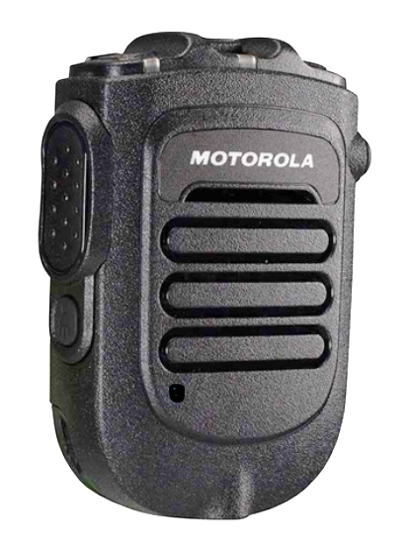
MOTOROLA SOLUTIONS ACCESSORIES
HANDSET
Up to 28 hours talk-time
Standby time: 51 hours
Robust design to IP55 standard
Dedicated PTT buttons for use with gloves
LED indicator for Bluetooth and audio status
Volume control level
Windporting microphone
3.5mm audio jack
Task light
Detachable battery
Dual unit charger
Emergency button
RLN6562B Kit (PMMN4096)
Operational Critical Wireless RSM
(Android and LEX device)

Slide 6
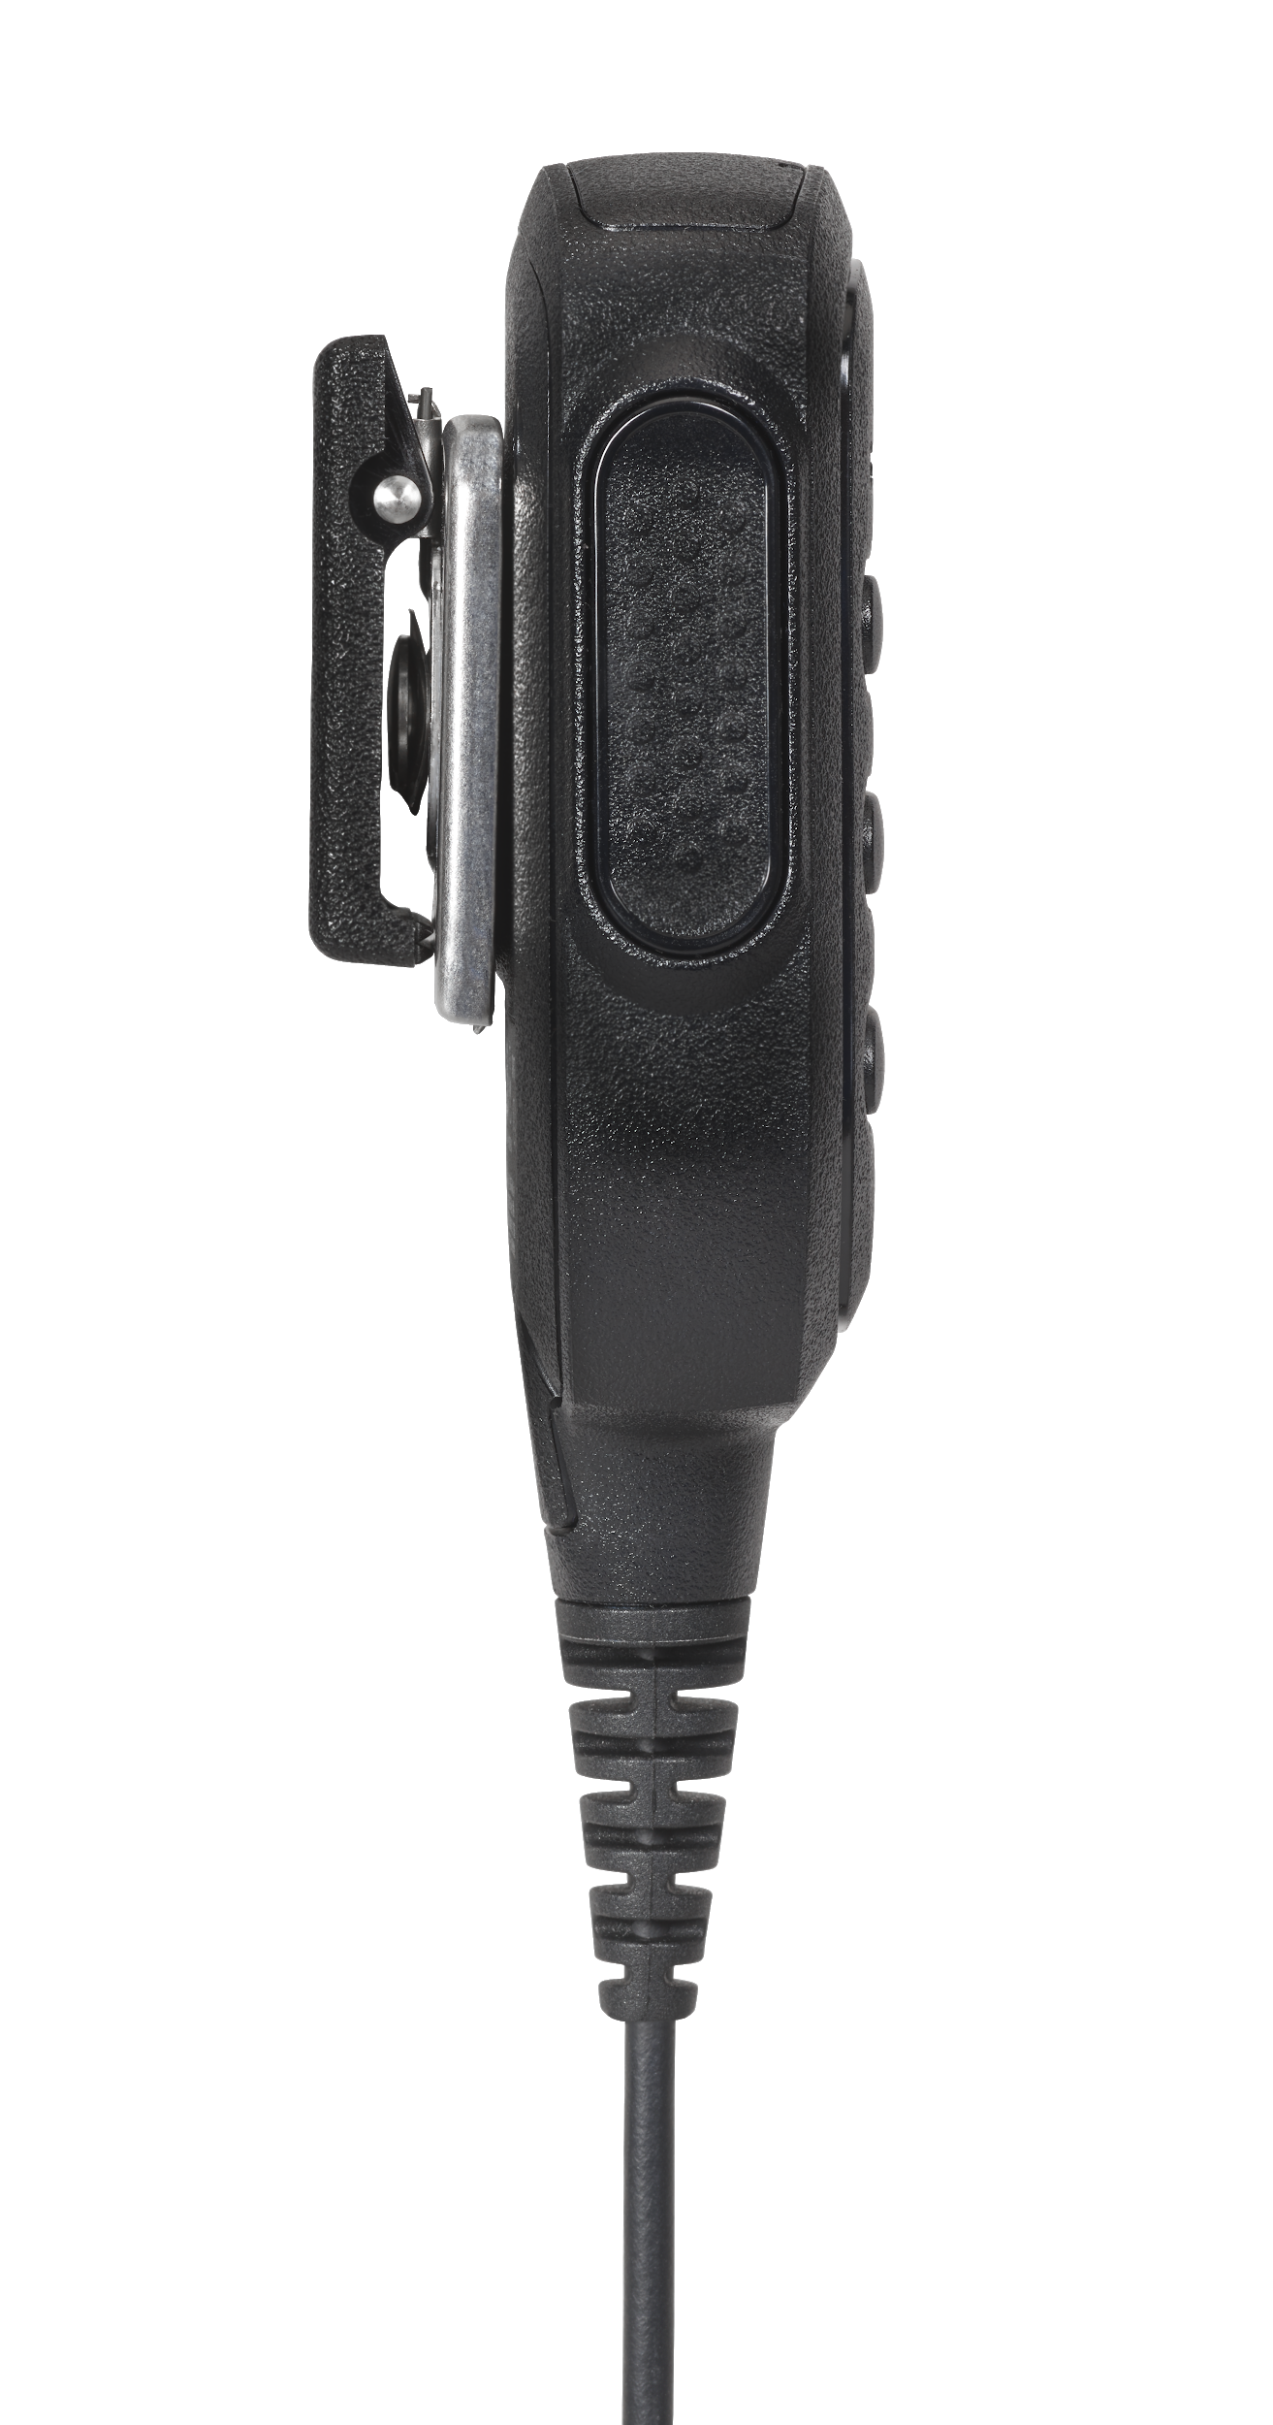
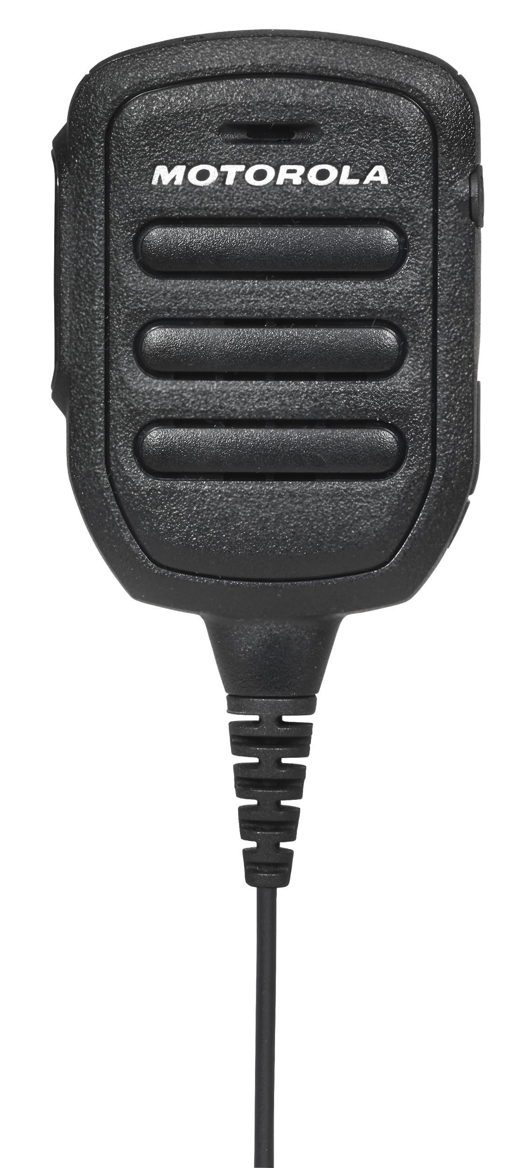
MOTOROLA SOLUTIONS ACCESSORIES
HANDSET
Microphone
Up to 22 hrs talk-time
Robust design IP67 standard
Dedicated PTT button for use with gloves
LED indicator for charging and audio status
Windporting microphone
3.5mm audio jack
Automatic ON/OFF when plugged in or removed from the radio
Embedded battery - replaceable
Audio Jack
Speaker
Press-to-Talk (PTT) Button
Micro-USB charging
PMMN4125B
RM250 Remote Speaker Microphone
(TLK 100 / TLK150)

Slide 7
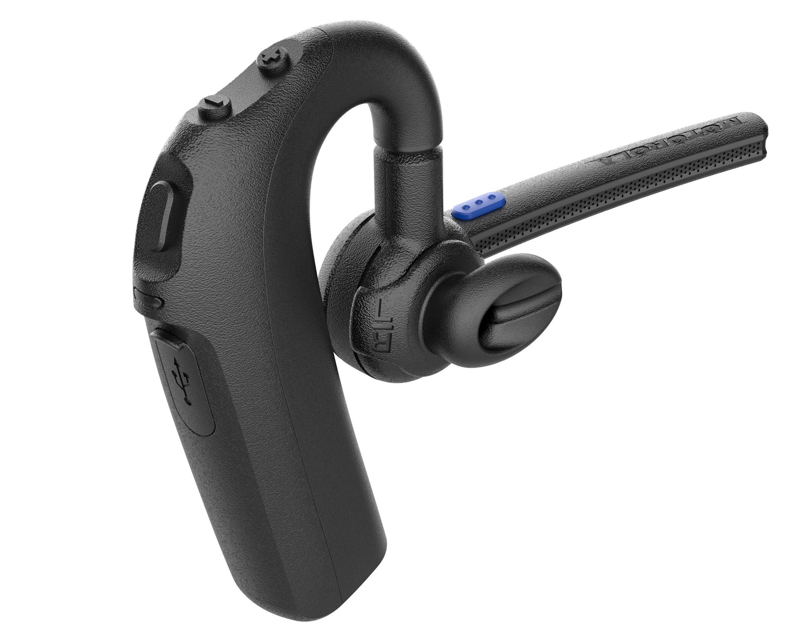
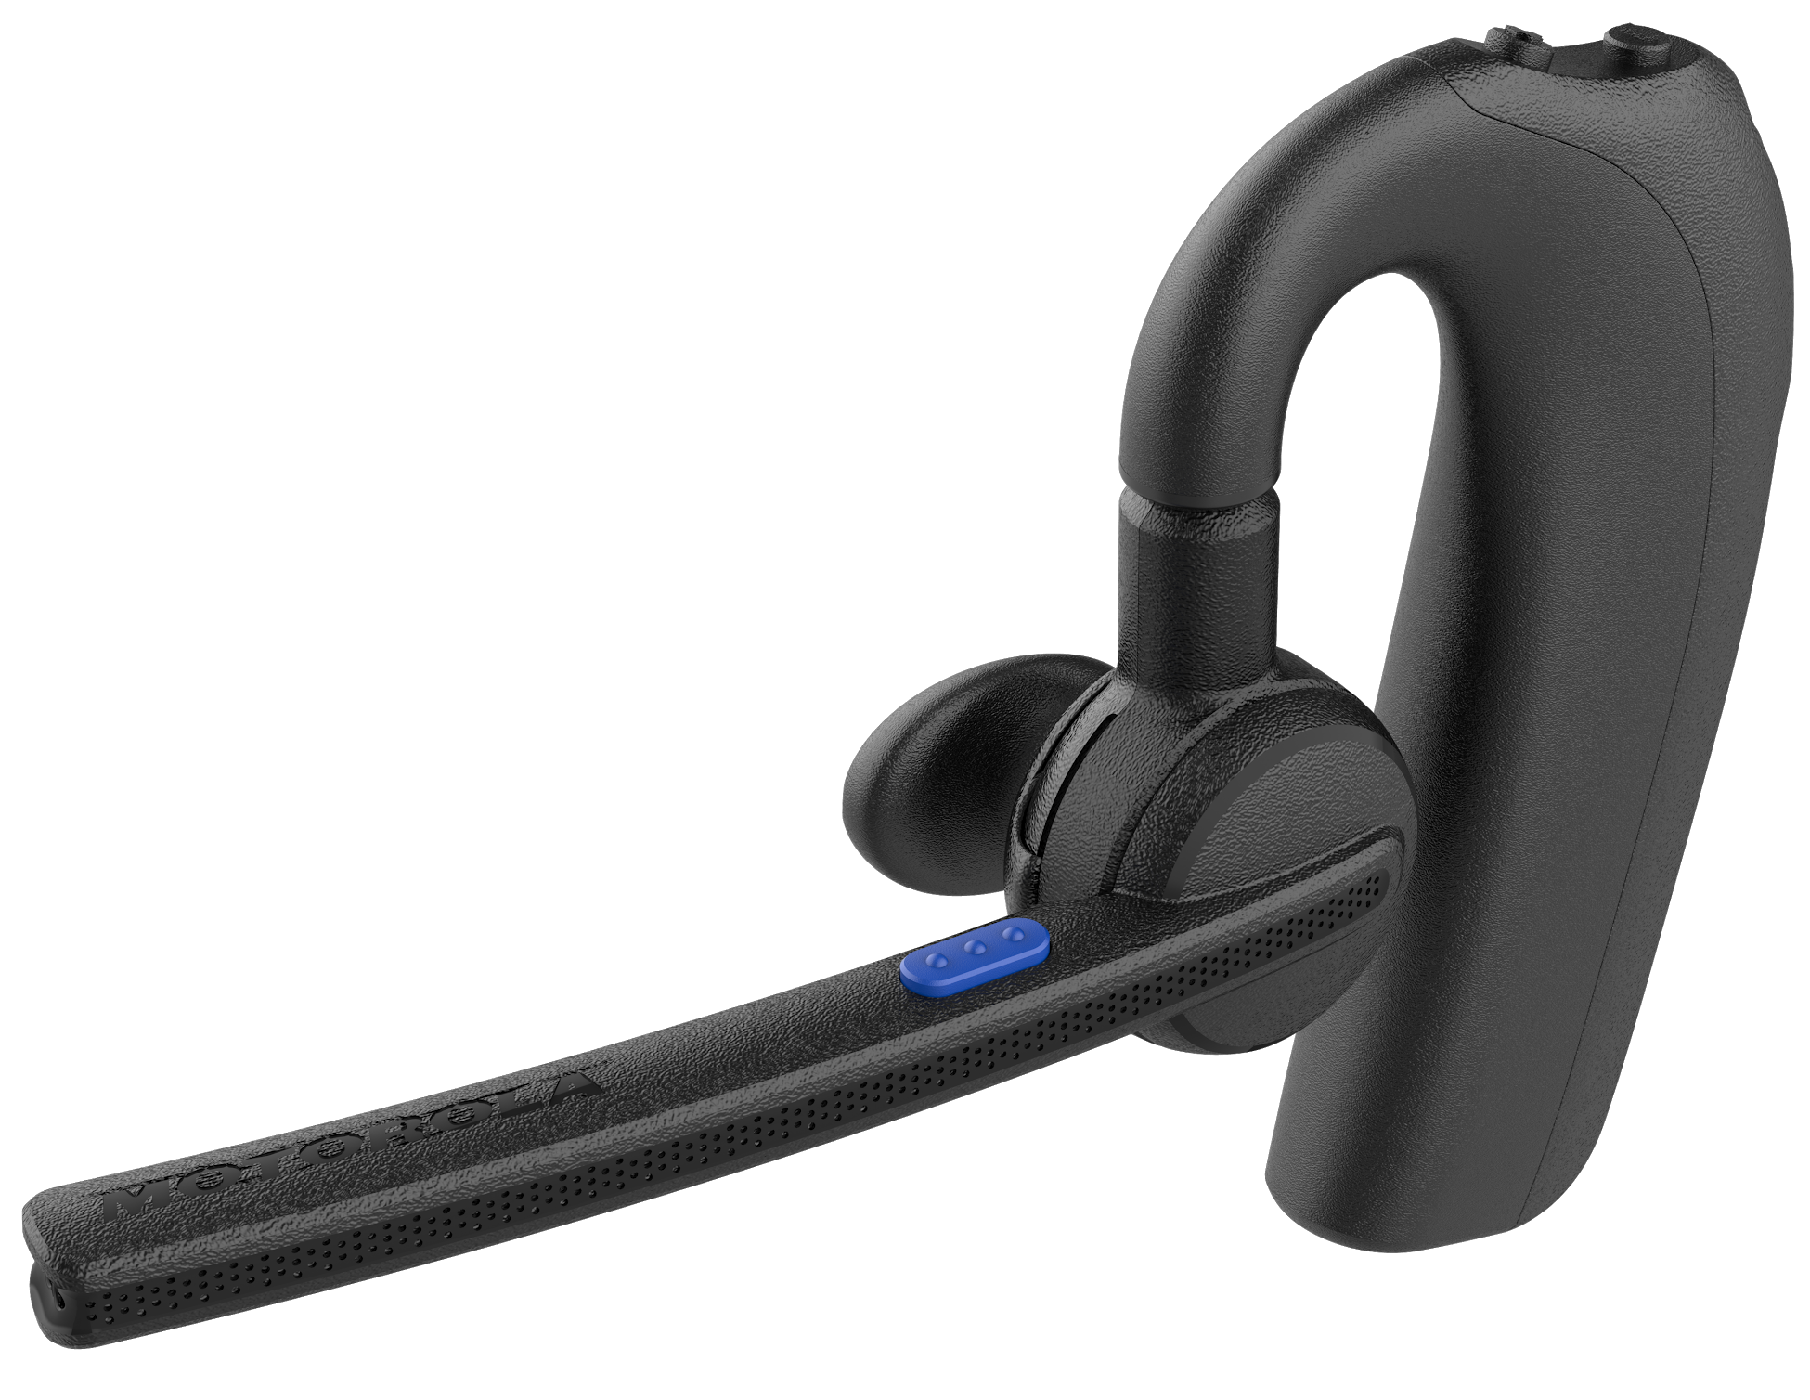
MOTOROLA SOLUTIONS ACCESSORIES
EARPIECE
Dedicated PTT button (blue color)
Loud & clear audio (10dB louder than EP900w)
Compact ergonomic design (rounded earbud)
Wide array of earbud options (oval or round; small, medium, or large)
8-hr talk-time; 70-hr standby time (LTE mode)
2-hr charging time
Dimensions - 4.23 ( L) x 1.04 in (W) x 2.83 in (H)
Weight - .81 oz.
Compatible with:
TLK100, TLK150, SLN1000, Evolve, Mototrbo Ion, LEX L11, Android smartphones.
Volume Buttons
Multifunctional Button (MFB)
PTT Button (blue)
180° rotatable for left/right wearing
Microphone
LED Indicator
Speaker
USB Charging Port
Up and Down Adjustable
Rotatable Boom Microphone
EP910W
Wireless Bluetooth Earpiece
(TKL100/TLK150)

Slide 8
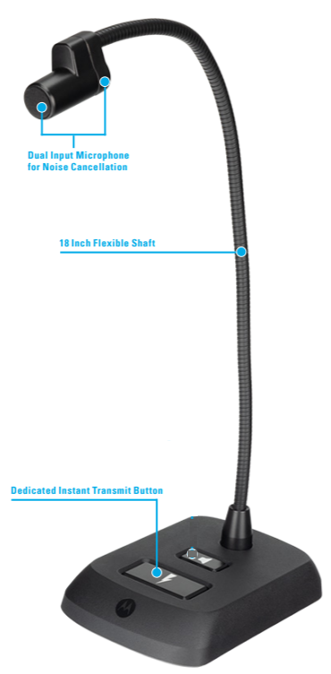
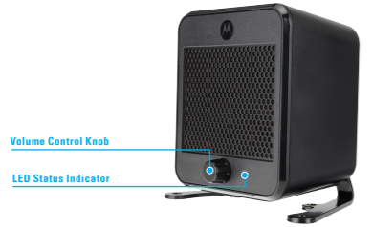
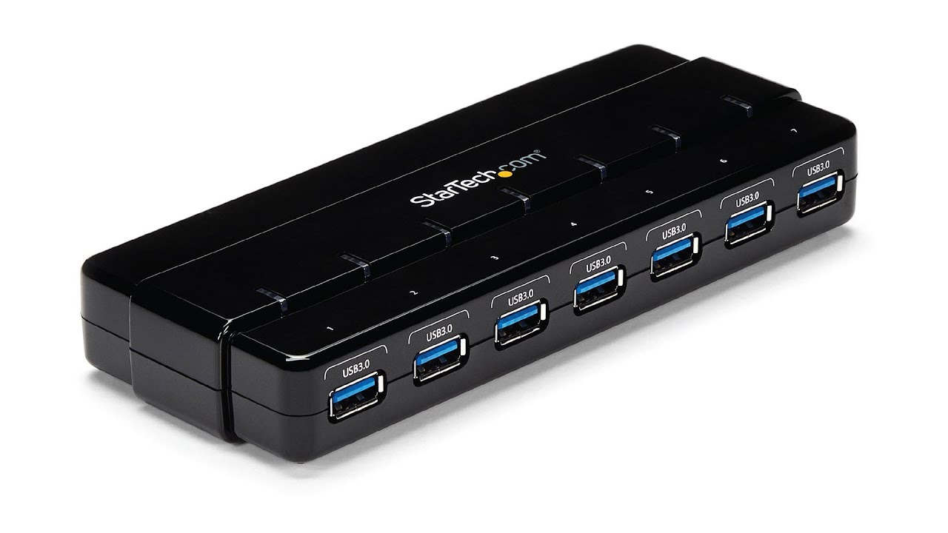
MOTOROLA SOLUTIONS ACCESSORIES
DISPATCH
USB Desktop Speaker
(B1952)
7-Port USB 3.0 Hub- Desktop
(ST7300USB3B)
USB Gooseneck Microphone
(B1951)

Slide 9
3rd Party Accessories

Slide 10

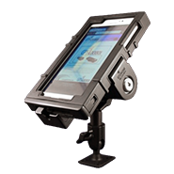
CAR KIT ACCESSORIES
GPS LOCKBOX
Durable impact resistant case with a locking bracket that mounts in a vehicle
Secure car kit lockbox for smartphones and tablets

Slide 11


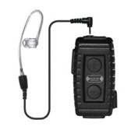
EARPIECE ACCESSORIES
EARPHONE CONNECTION
Dependable all day talk-time (~12 hrs.)
Clip onto lapel or clothing
Clear audio transmission
Acoustic tube lowers radiation emission
Microphone element with windscreen
Nighthawk
Lapel Mic with Earpiece
(Android)

Slide 12


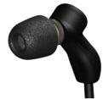
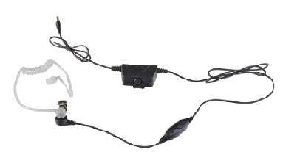
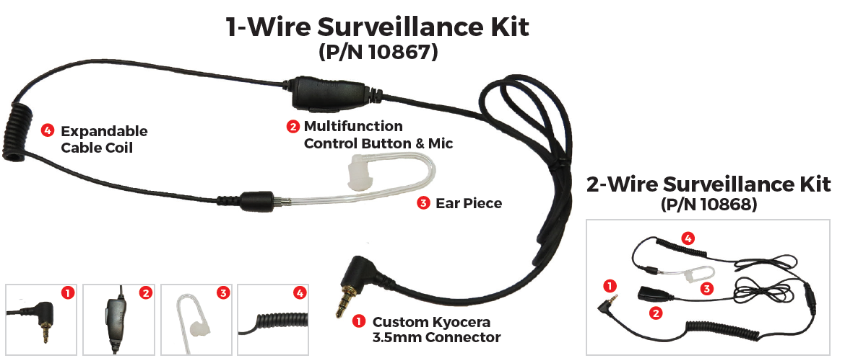
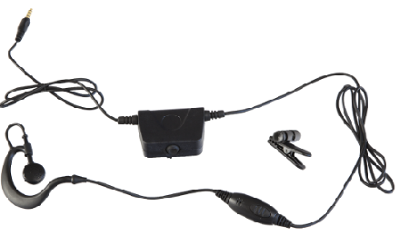
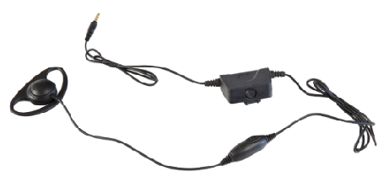
EARPIECE ACCESSORIES
MILICOM
Milicom IN-EAR MIC
Earpiece (Android/iOS)
Acoustic Tube
Earpiece (Android/iOS)
D-Loop
Earpiece (Android/iOS)
Milicom acoustic tube with 5-pole connector (Kyocera DuraXV)
Earhook Earbud
Earpiece (Android/iOS)
Acoustic tube style design combines 2-in-1 call & PTT capabilities
Custom Kyocera phone compatible 2-in-1 headset
Familiar, clear loud acoustic tube ear piece design
Multifunction button controls call Answer/End and PTT Operations
1-Wire and 2-Wire single ear headset configurations
Crystal clear communications at all times
Patented in-ear canal mic delivers superior voice quality
Whisper capability in all weather and noise conditions
Superior noise isolation ensures clear sound and protects hearing
Dual or single ear headset configuration
Durable, Kevlar-reinforced cable provides 20 pounds of pull strength
Industrial grade design for all commercial uses

Slide 13

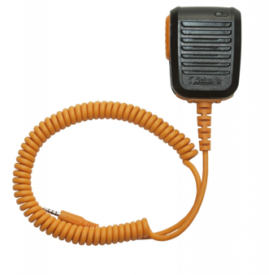
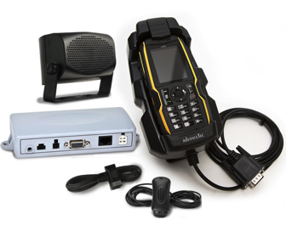
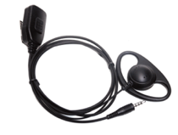
HANDSET ACCESSORIES
ADVANCETEC
Easy-to-access PTT button
Micro USB compatible charging
3.5mm audio socket for wired ear piece for privacy communications
Multicolor LED battery indicator
Optional single and four bay drop-in charger
Power from 12VDC- 24VDC
Loud and clear audio via 10-watt speaker and noise cancelling visor microphone
Secure cradle provides protection and safety while operating your phone
Remote push-to-talk control button
Fast battery charger
AdvanceRSMTM
(BREW clients)
Car / In-Vehicle Kit
Discreet and secure D-loop style earpiece
EPTT housing clips to lapel or collar for ease of use
Sleek design provides excellent stability and communications quality
User-replaceable coin-cell type battery (CR2032)
D-Loop Headset with PTT Button
(Android and BREW)

Slide 14

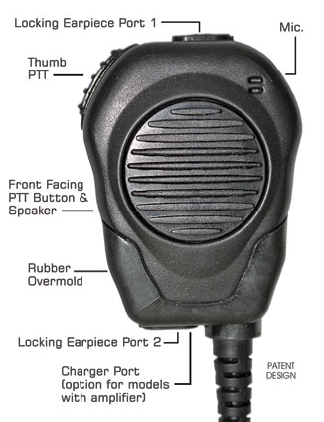
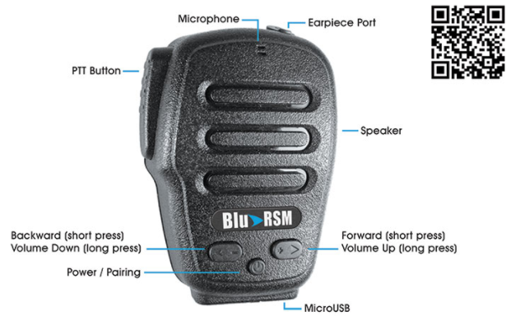
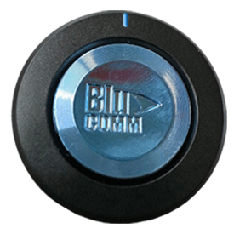
HANDSET ACCESSORIES
KLEIN ELECTRONICS
Blu-PTT
(Android/iOS)
Blu-RSM
(Android/iOS)
VALOR RSM
(Android/iOS)
Rugged speaker/microphone with volume control, PTT button and earpiece port
Only Android Compatible, iOS coming soon
20/500 hour talk/standby time
Long life replaceable battery
IP64 rated
Charging -2-3 hours
Range 90 ft
PTT button
Based on BT Low Energy
Lasts 18 months
Ideal when PTT needs to be separated from audio
Rubber overmold
2 audio ports with locking cams
Contoured edges for grip and feel
3-year warranty
Comes in black or safety orange

Slide 15

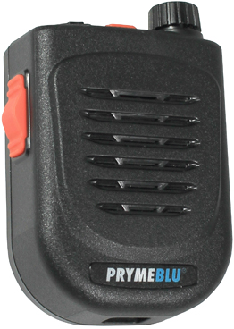
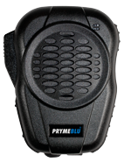
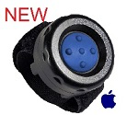
HANDSET ACCESSORIES
PRYME
BTH-500-U with rotary volume control
IP56 certified
Noise canceling microphone
Typical operation range: 10 meters
Talk-time: 40+ hours; standby 30 days
Side mounted PTT switch, top mounted cellphone control switch, and 3.5 jack for optional earphone
40 hours talk-time
Waterproof front-facing speaker
Directional noise cancelling mic
3.5 mm earphone jack
IP56 rated
Rechargeable/replaceable battery
BTH-600-KU
Bluetooh RSM
Android and iOS
BTH-500-U
Android and iOS
Works for up to 2 years
Ideal for one-touch operations
BT-PTT-U MINI
Bluetooth button
iOS only

Slide 16

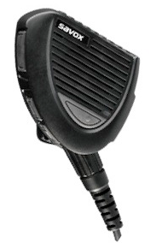

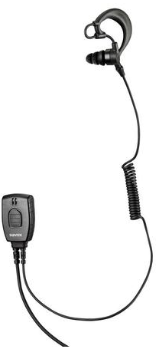
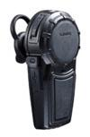
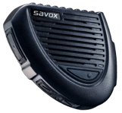
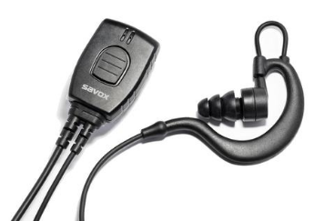
HANDSET ACCESSORIES
SAVOX
RSM-30 Remote Speaker Mic
(Android, iOS, Sonim)
BTR-155 Bluetooth RSM
(Android and Sonim versions)
BTH-101 Bluetooth Headset
(Android)
Promate SH-01 Wired Headset
(Android)
Up to 80 hours talk-time
Superior audio quality
Micro-USB charger
Full duplex call capability
Large buttons for use with gloved hands
Volume control
Durable (IP55)
Rotating belt clip
Ergonomic
Optimal size
Up to 30 hours talk-time
Robust design to IP55 standard
Large buttons for use with gloves
Lightweight
Includes volume and multifunction buttons
Long battery life
Supports standard full duplex phone calls
Jack socket for external earpiece
Robust design to IP55 standard
Large buttons for use with gloves
Can be used with goggles and glasses
Extremely comfortable for wearing over long periods of time
Can be worn on the right or left ear
Supports standard full duplex phone calls
3.5mm headset/earpiece connector
Toggle and latch functionality with PTT
Dirt and moisture tolerant (IP67)
C-shaped earhook for secure and comfortable use
Best fit to your ear by different size earbuds
Good tactile feel on the press button, easy to use even with gloves

Slide 17

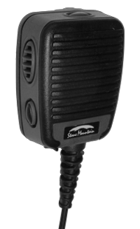
HANDSET ACCESSORIES
STONE MOUNTAIN
IP68 Waterproof – 1 meter/31 minutes
Meets/exceeds military environmental specs (MIL 810G)
Large, super tactile side PTT
Optional One touch Hi/Lo volume button
SureSealTM 3.5mm Rx audio jack
1,100 mAh Li-Ion extra long life battery
Optional CallCheckTM message record, store and playback
Optional Vehicular Charger
Patent pending FasNTM connector retention system eliminates:
  Accidental device connector disengagement
  Damage to device connector
  Loss of device
PHOENIX RSM
with voice recording (Android)

Slide 18


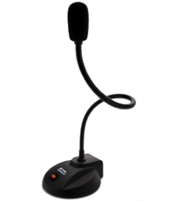
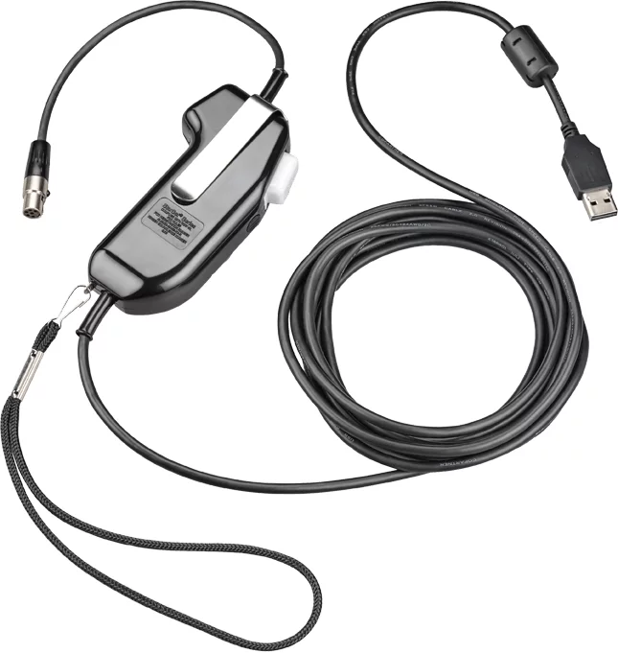
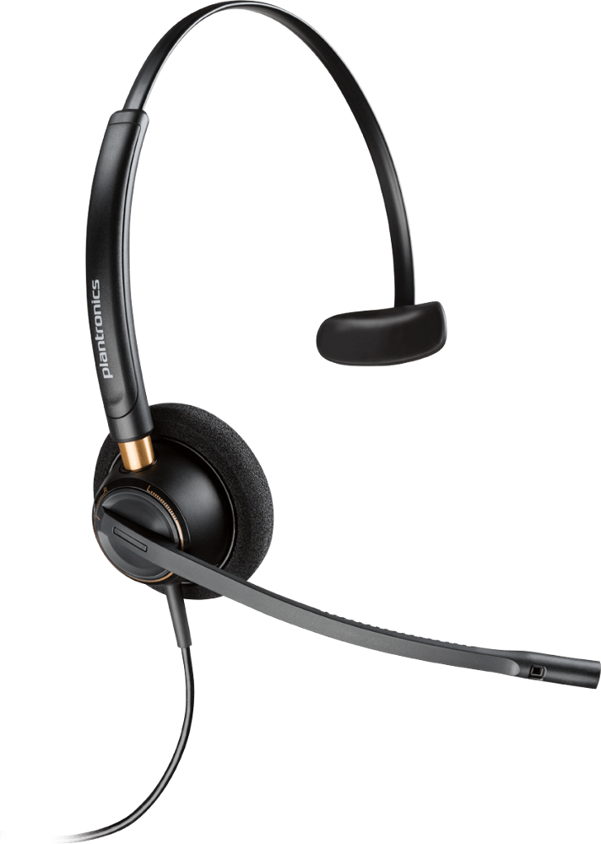
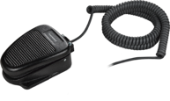
DISPATCH ACCESSORIES
Poly , Buddy MICROPHONES
Adapter with PTT Button
(SHS 2355-11)
EncorePro HW520 (89434-01)
Foot Pedal / Switch
(SSP 2646-­11)
Desktop Mic 7G
Dispatch

Slide 19

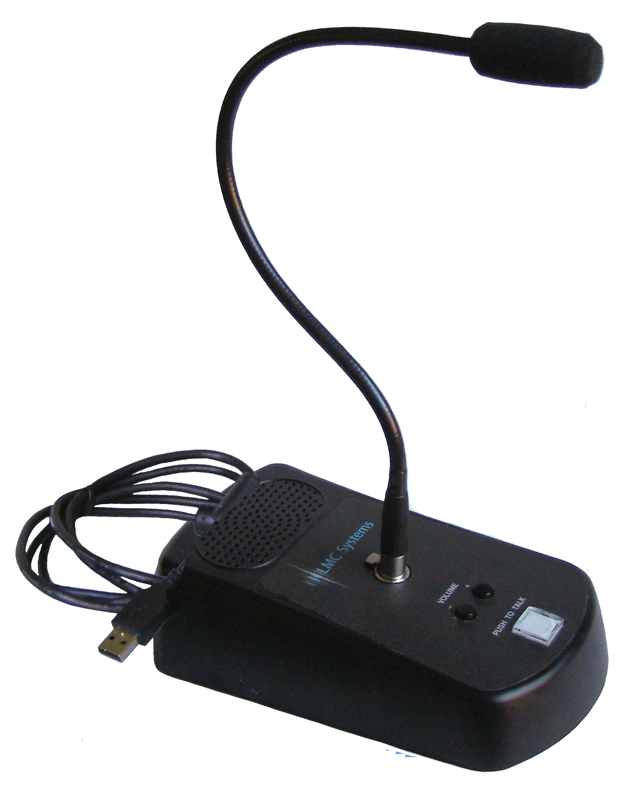
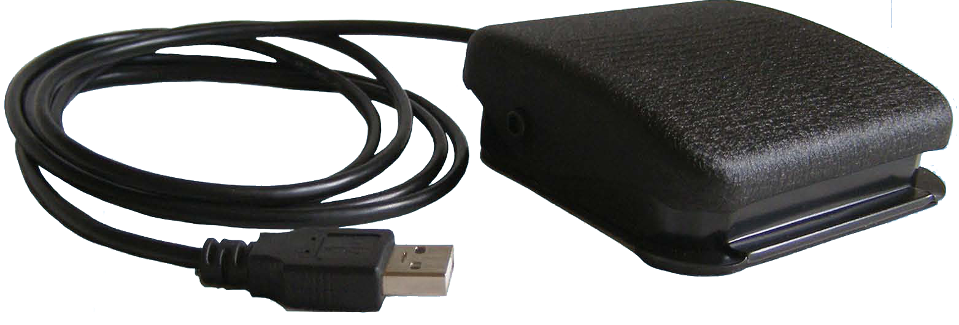
DISPATCH ACCESSORIES
LMC SYSTEMS
Built-in speaker
Noise canceling microphone
Blue and red LED's built into the PTT button to show the status of the microphone
USB 2.0 uses HID drivers native to Windows
Runs on USB power
No external power required
Compatible with XP, Vista, 7, 8, 10
Removable microphone for mobile applications
Company branding available
SLIM Microphone / Speaker Station
Foot Pedal
(FTT-300)

Slide 20


