Slide 1
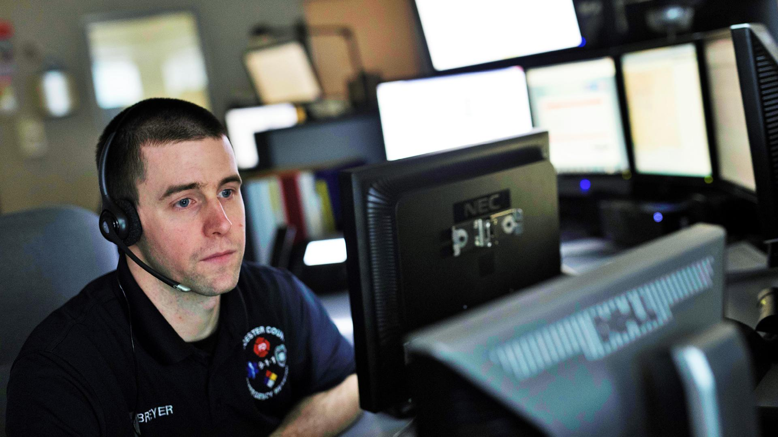

IT STARTS WITH THE CALL
NG9-1-1
VESTA AND CALLWORKS

Slide 2
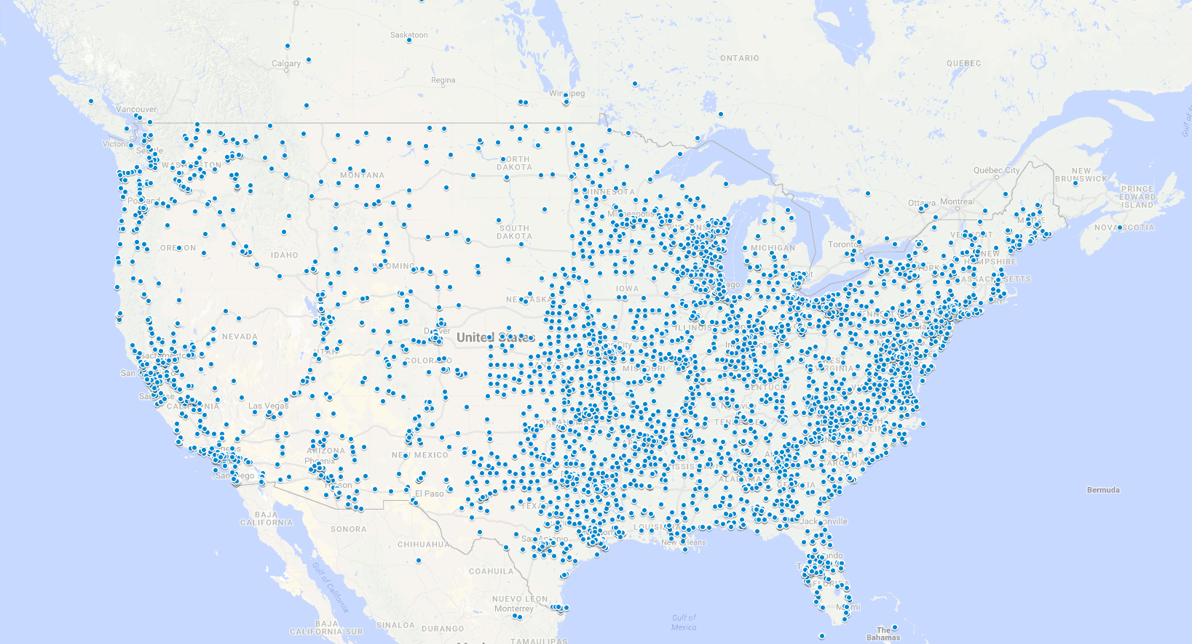

VESTA AND CALLWORKS PROTECTING OVER 200 MILLION IN THE U.S.
Serving 3,700 PSAPs in the U.S. and over 21,000 Positions
Boston
New York City
Chicago
Philadelphia
Los Angeles
Phoenix
Dallas
San Diego
Serving 9 of the 10 largest cities in the U.S.
San Antonio
Houston
Notes:
SCRIPT
This slide shows our Public Safety call handling locations for VESTA and CallWorks across the US and picture is worth a 1,000 words.
NOTE: Depending on who you are presenting to, it’s great if you can point out the location of the people you are speaking to and how many customers we have surrounding them.
.

Slide 3
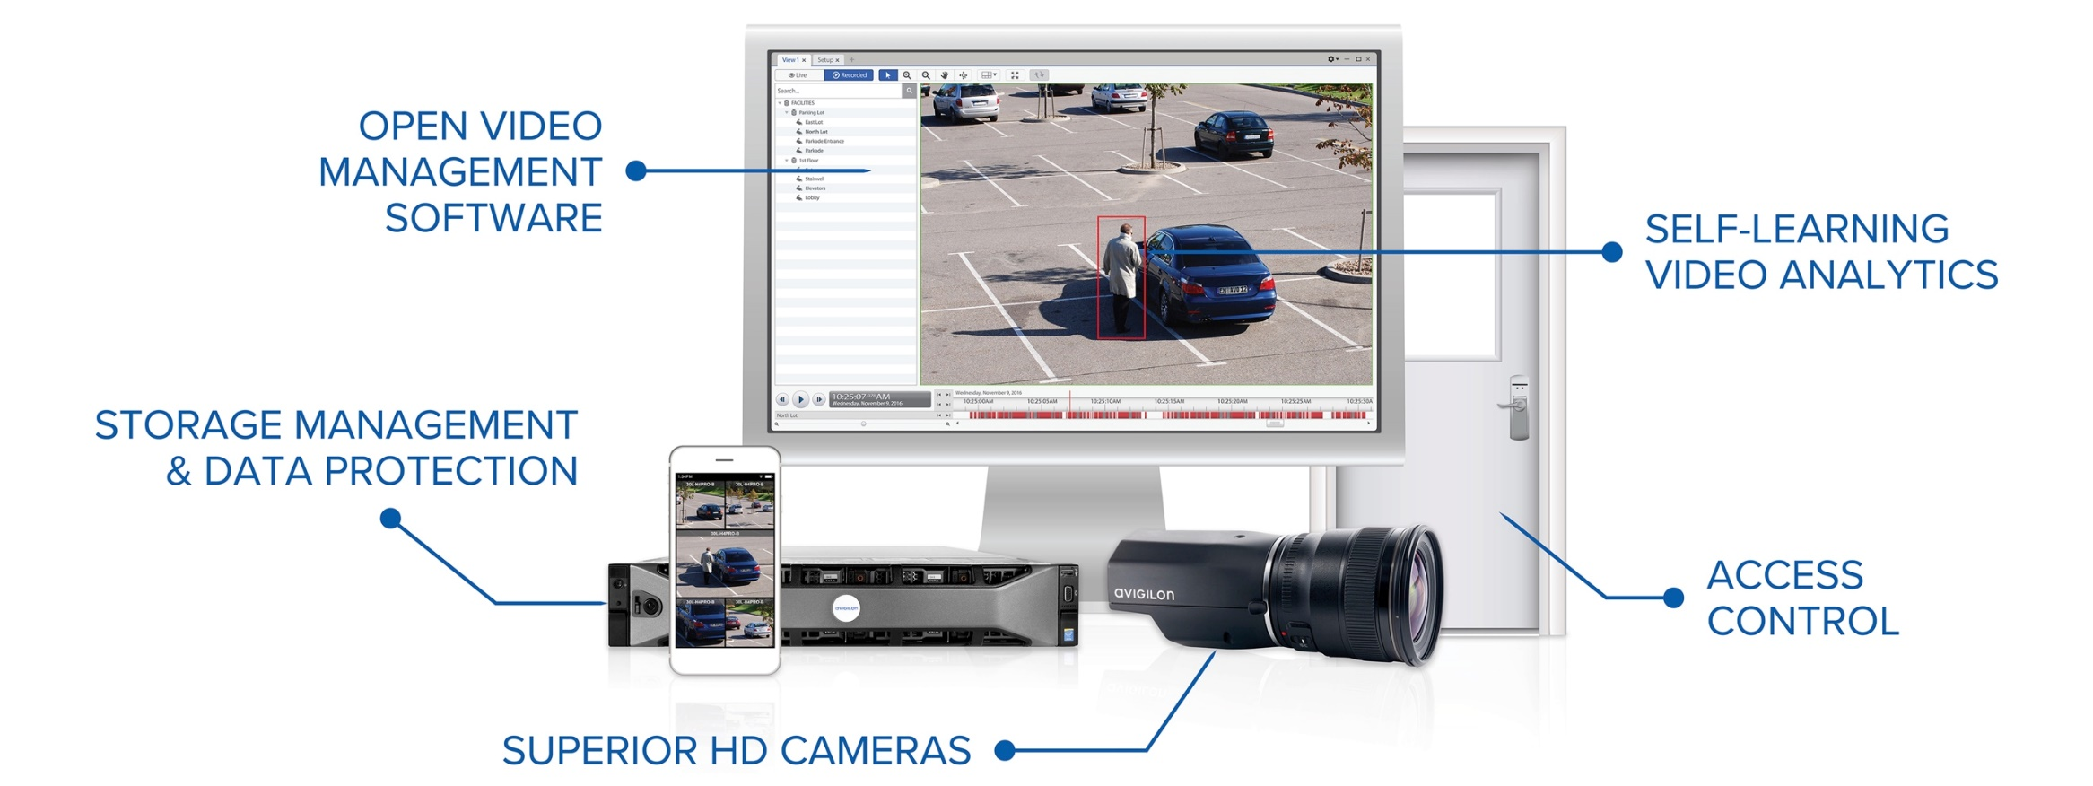




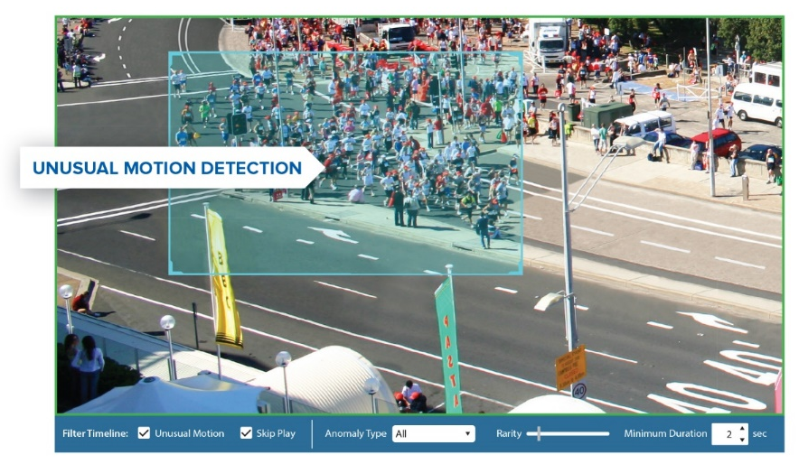
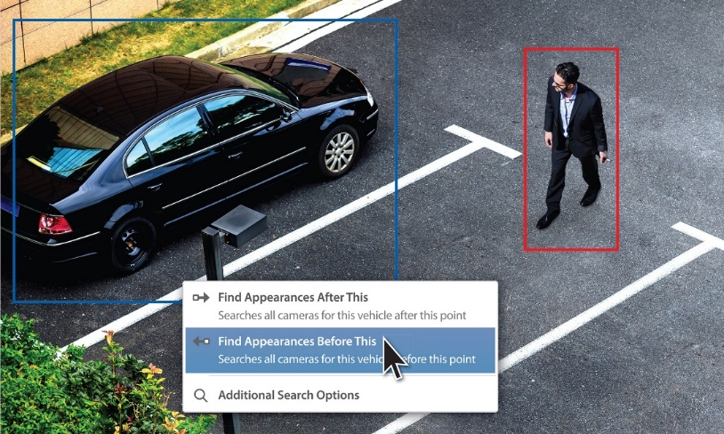
Avigilon | PROFILE
overview
Solutions
company
Founded 2004, Public 2011
x
Locations
HQ: Vancouver, BC; US HQ: Dallas, TX
Mfg: Richmond, BC & Plano, TX
x
Employees
1,100
Intellectual property
750+ Patents
15+ Licensees
Solutions portfolio
Avigilon Unusual Motion Detection (UMD) Technology
Avigilon Appearance Search Technology
CAMERAS
VIDEO ANALYTICS
VIDEO MANAGEMENT
STORAGE
End-to-End Video and Access Control Solutions

Slide 4
