Slide 1

Disaster Communication Recovery

Slide 2
IDOT Disaster Recovery Mission
Bureau of Operations policy is to promote the free flow of uninterrupted traffic on the State Highway System during and following both natural and manmade disasters. This will be accomplished by supporting systems that provide an accurate and up-to-date situational awareness of the disaster impact and provide personnel and equipment to assist other state agencies, local governments and non-governmental organizations as requested by the Illinois Emergency Management Agency.

Slide 3
Requirements
IDOT Yards represent all Federal/State Transportation Systems in 102 Illinois Counties
Yards must be able to gather information concerning the areas they serve
Yards must be able to get information to and from their District Headquarters
District Headquarters must be able to get information to and from Springfield

Slide 4
Current Situation
Normal Operation is established using SC21 and IDOT data network
No backup plan for voice communications at a yard level
No backup plan for yard to District Headquarters voice communication
Limited backup plan in place for District Headquarters to Springfield voice communication
Limited plan in place for network connectivity from District Head Quarters to Springfield
Cannot rely on unplanned site trunking
Cannot develop and train a plan based on unplanned site trunking

Slide 5
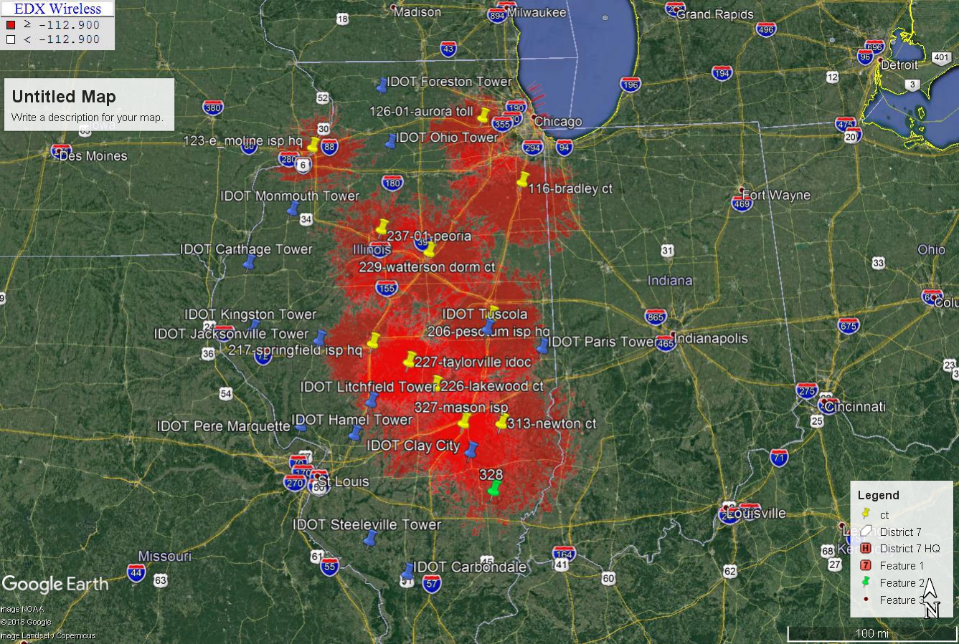
Existing Interop and IDOT tower locations

Slide 6
IDOT District Headquarters/ SC21 sites

Slide 7
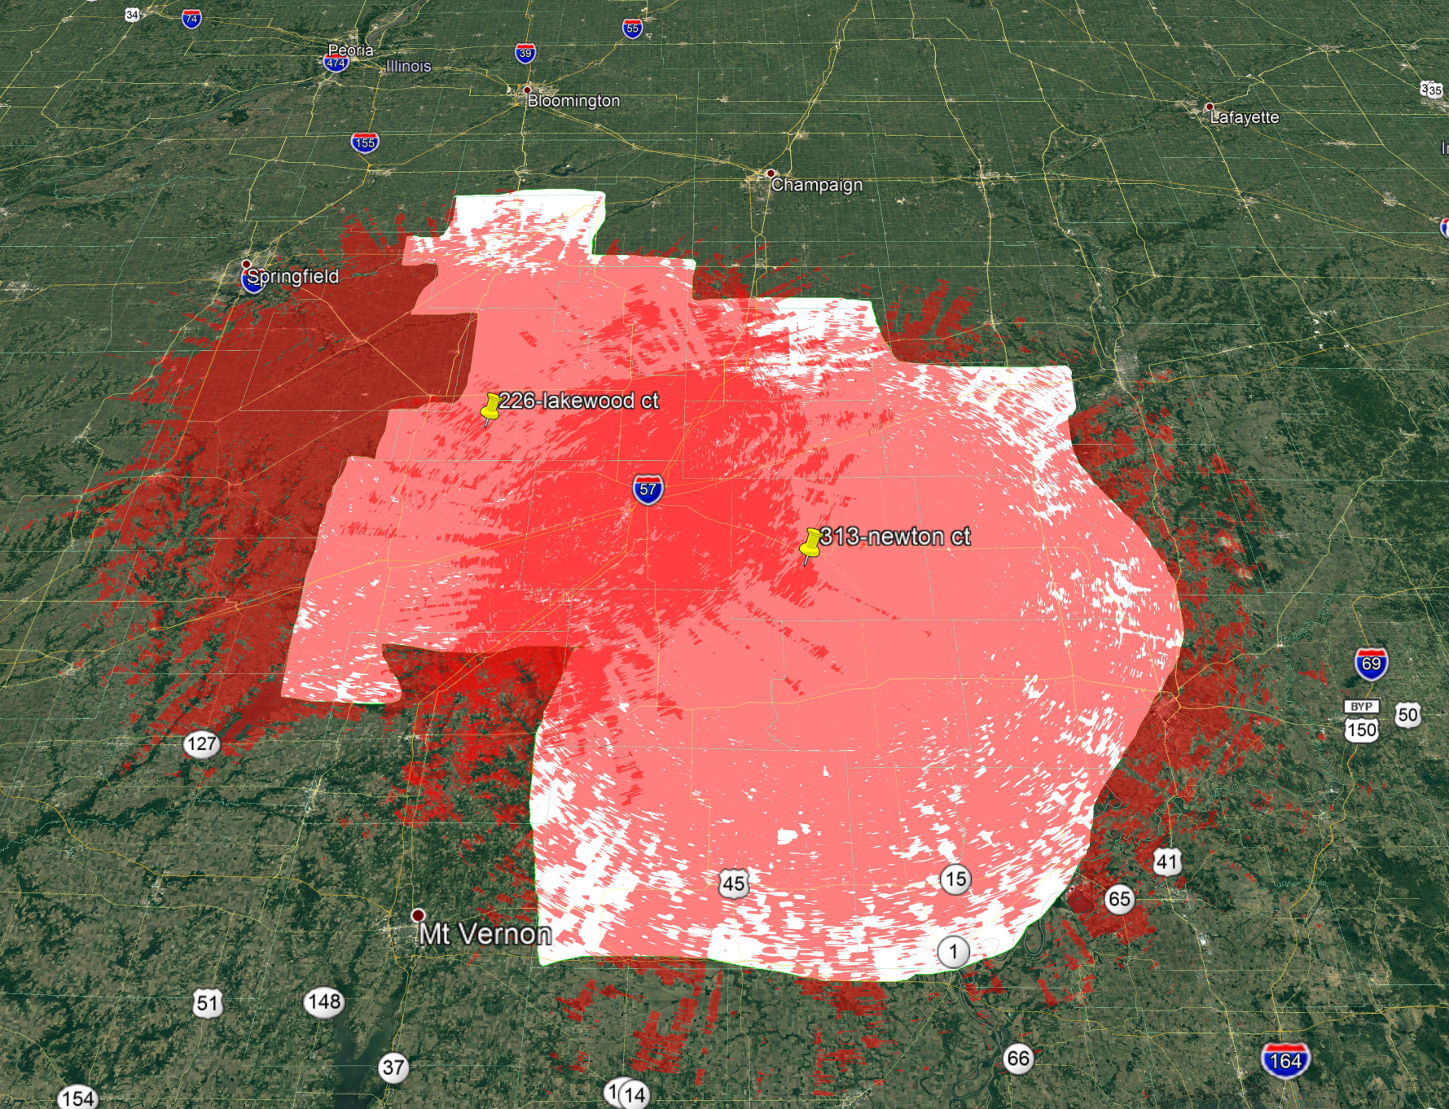
SC21 Towers Covering IDOT District 7

Slide 8
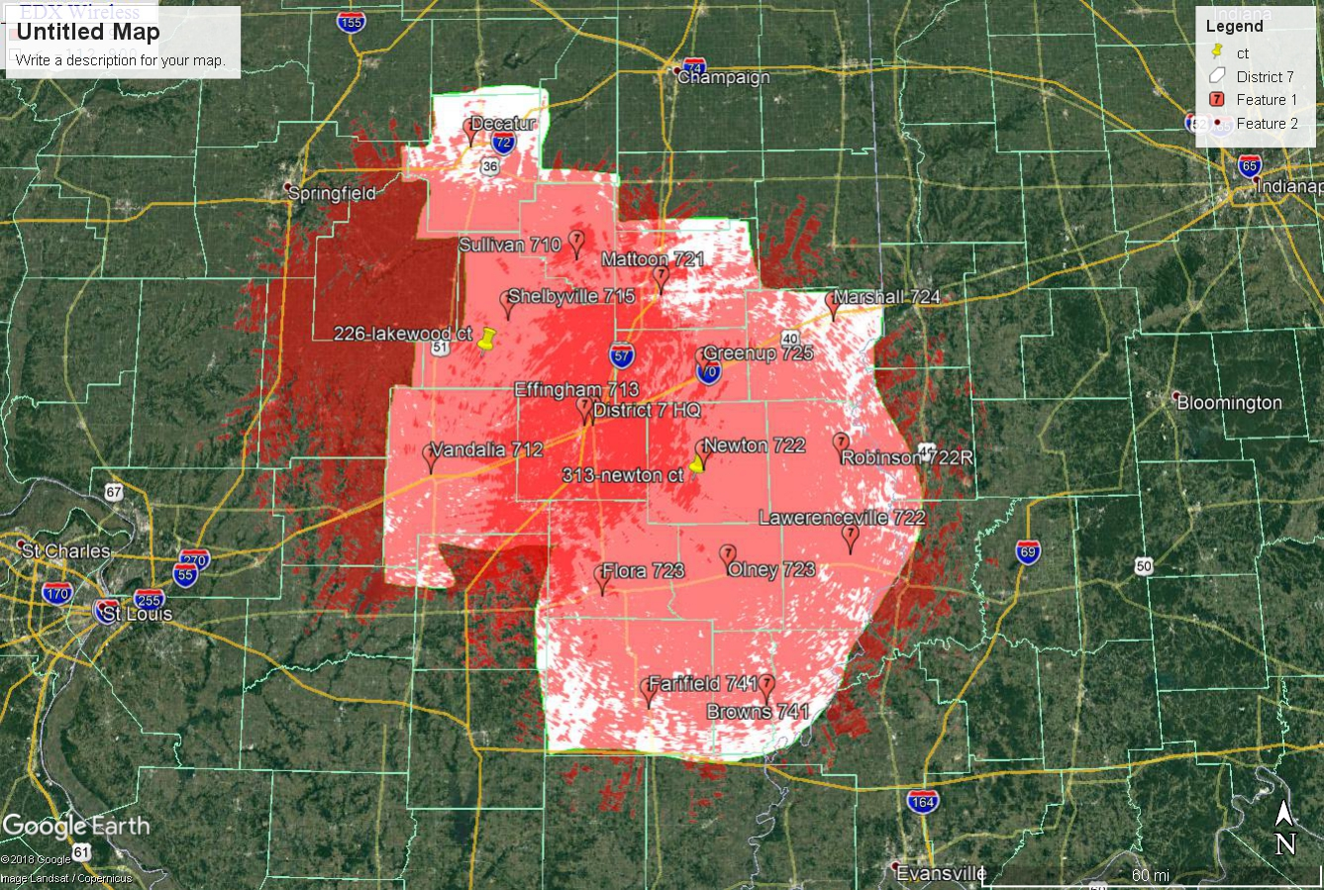
IDOT District 7 Yards and Coverage

Slide 9
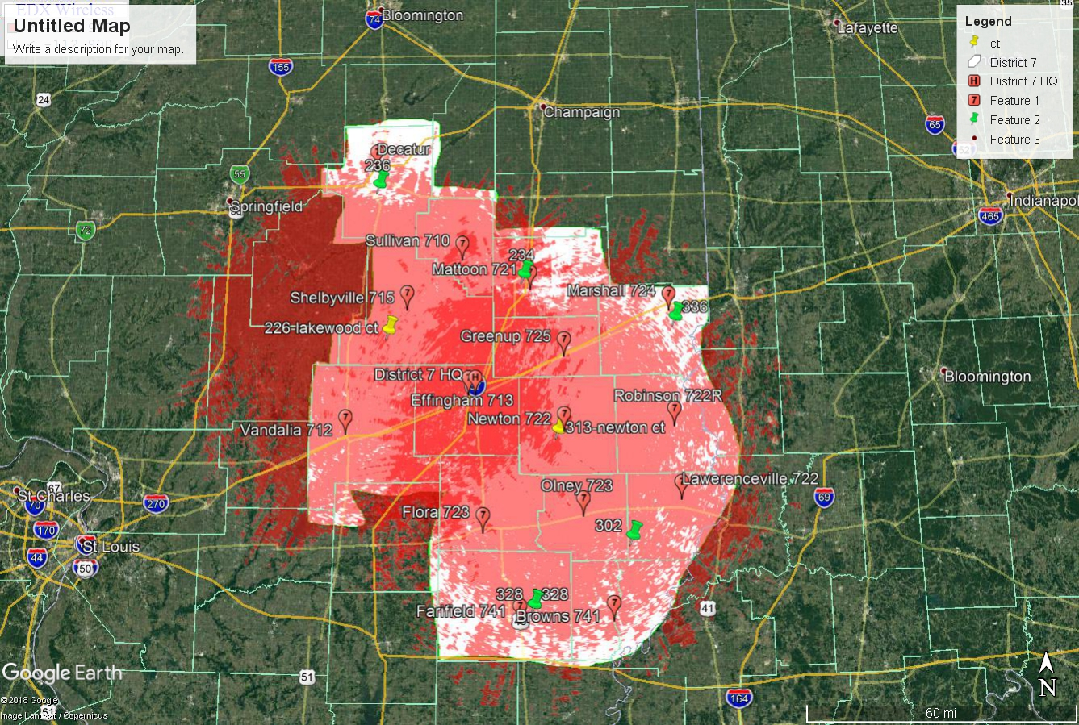
Yards Covered By Additional SC21 Towers

Slide 10
IDOT District 7 Backup Zone
Mode | Channel Name | Use
1 | D7BU A | Site 226
2 | DC711B | Site 236
3 | MT721B | Site 234
4 | LV722B | Site 302
5 | MR724B | Site 336
6 | FF741B | Site 328
7 | D7BU B | Site 313
8
9
10
11
12
13
14
15
16

Slide 11
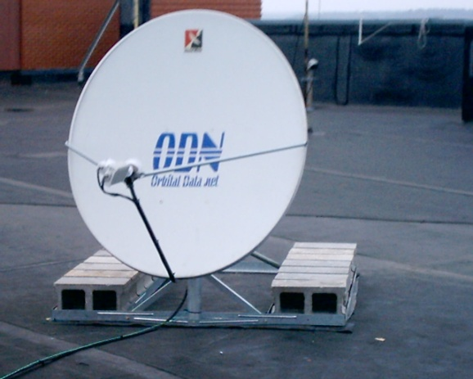

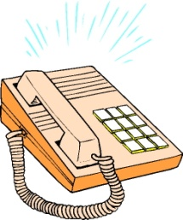
District to District/Springfield
IDOT Network
WAVE
Compass Trac (GPS/AVL)
VoIP Telephone

Slide 12
Requirements
Yards must be able to gather information concerning the areas they serve
Yards must be able to get information to and from their District Headquarters
District Headquarters must be able to get information to and from Springfield

