Slide 1
2018
Illinois Public Safety Communications
Planning to use the
Public Safety Broadband Network
This presentation was prepared by the Illinois SLIGP using funds under award from the National Telecommunications and Information Administration (NTIA), U.S. Department of Commerce (DOC). The statements, findings, conclusions, and recommendations are those of the author(s) and do not necessarily reflect the views of the NTIA, DOC, or FirstNet.
Joe Galvin Bill Springer
Lori Bell
Illinois Public Safety Communications Team
October 2017

Slide 2
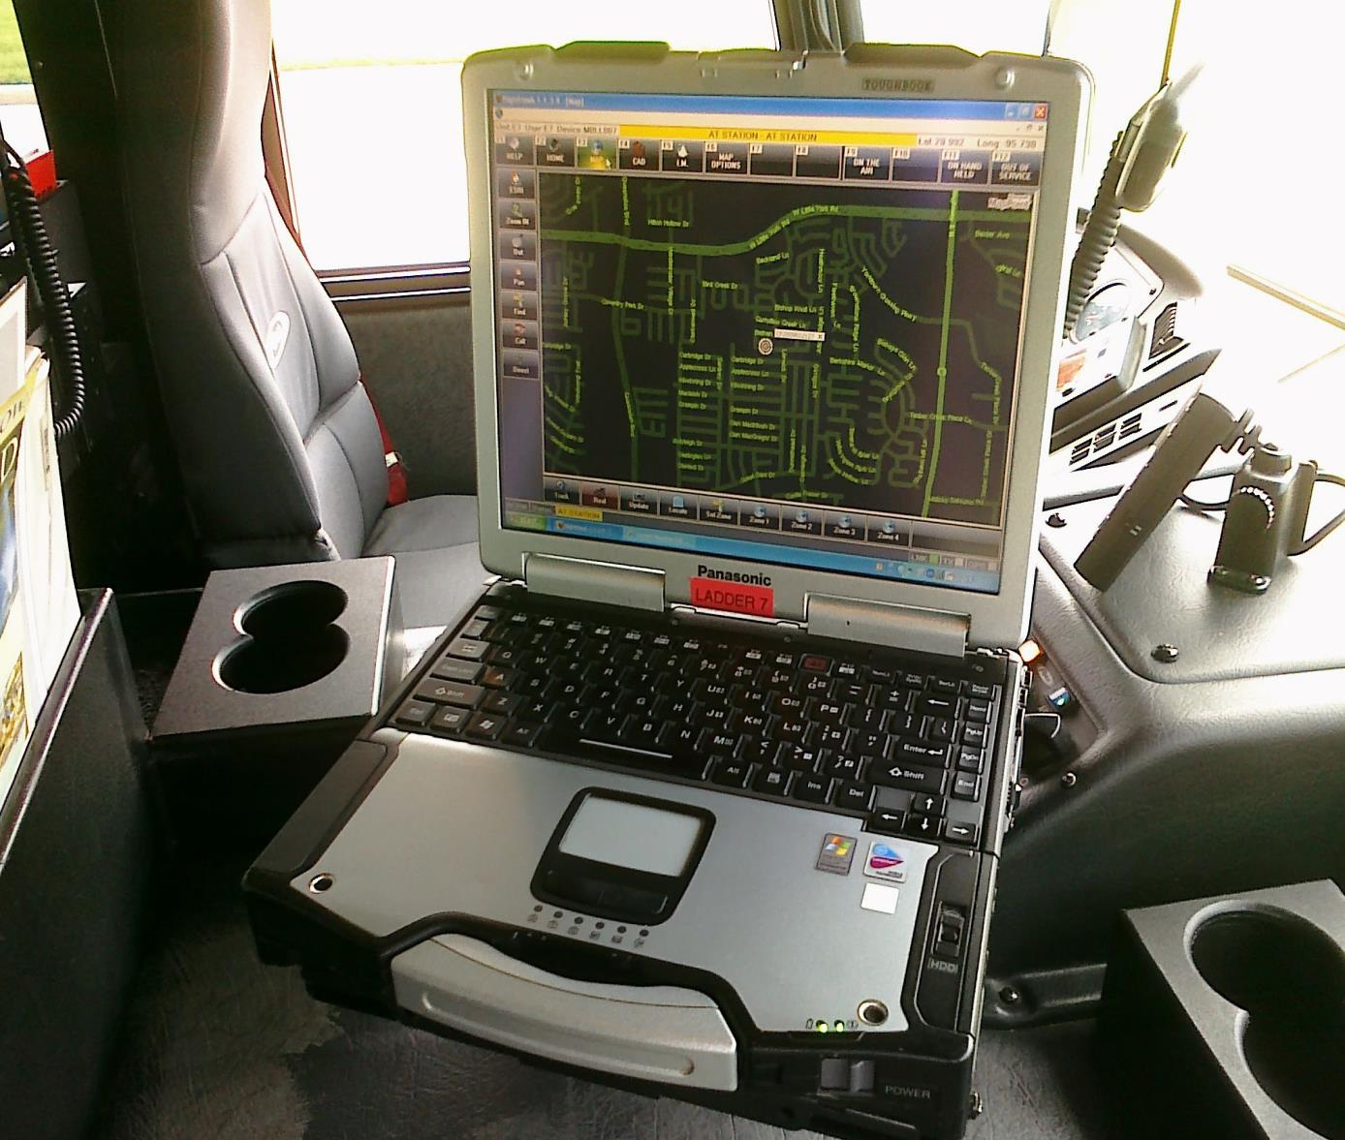
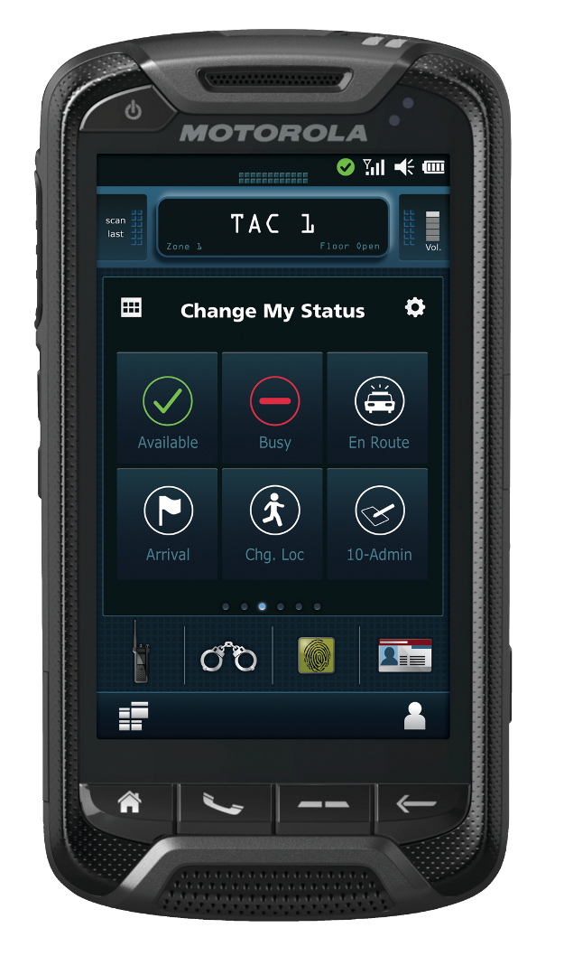
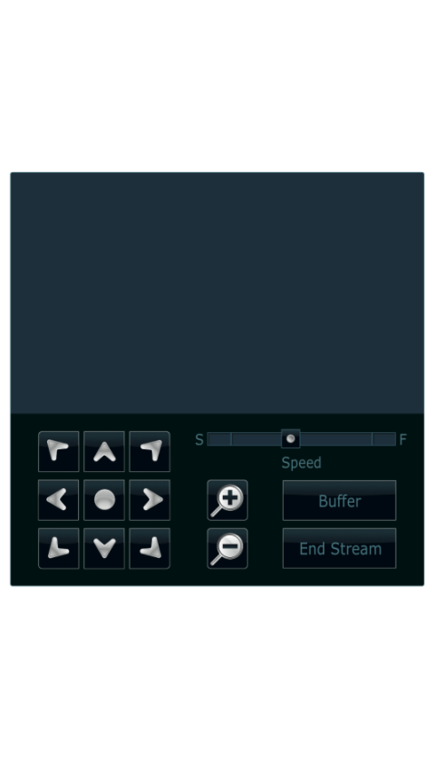
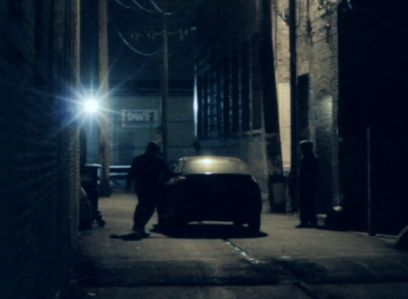

What is FirstNet
Dedicated nationwide LTE Broadband network for public safety – Focus on cellular-type voice, data, & video
No requirement for you to use FirstNet
LTE is NOT a replacement for LMR walkie-talkies

Slide 3
What is FirstNet
Follows 3GPP LTE Standards
Priority and Preemption

Slide 4
Cost
From the Beginning the State of Illinois has told FirstNet that the pricing needs to be Competitive or the decision is easy
Pricing appears competitive.
Pricing is a baseline, large quantity pricing for agencies in a possibility

Slide 5
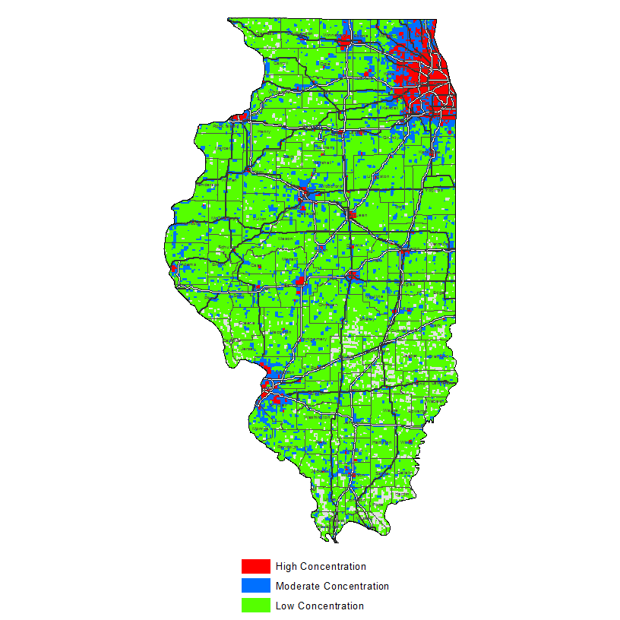
Coverage
Carriers measure coverage differently on their maps.
Public Safety is used to Guaranteed Coverage Maps.
Key: You Can Test before you commit
Run a “Speed Test” application

Slide 6
QPP
Quality of Service, Priority, and Pre-emption
Primary Users
Police, Fire, EMS, EMA, 911
Extended Primary Users
Transportation, Public Works, Public Health, etc.
Network Busy or Overloaded?
Priority gets you the next available opening
Pre-Emption bumps the low-priority users

Slide 7
PTT
LTE PTT is not considered Mission-Critical, i.e., it is not Public Safety grade
Still to be proven in a true Public Safety role
PTT on day one may be for some users
Non-Frontline, Commanders, non-life-safety, etc.
LMR is Here to Stay
Plan to stay on LMR for a decade (or longer!)
Look for Hybrid Networks and Radios

Slide 8
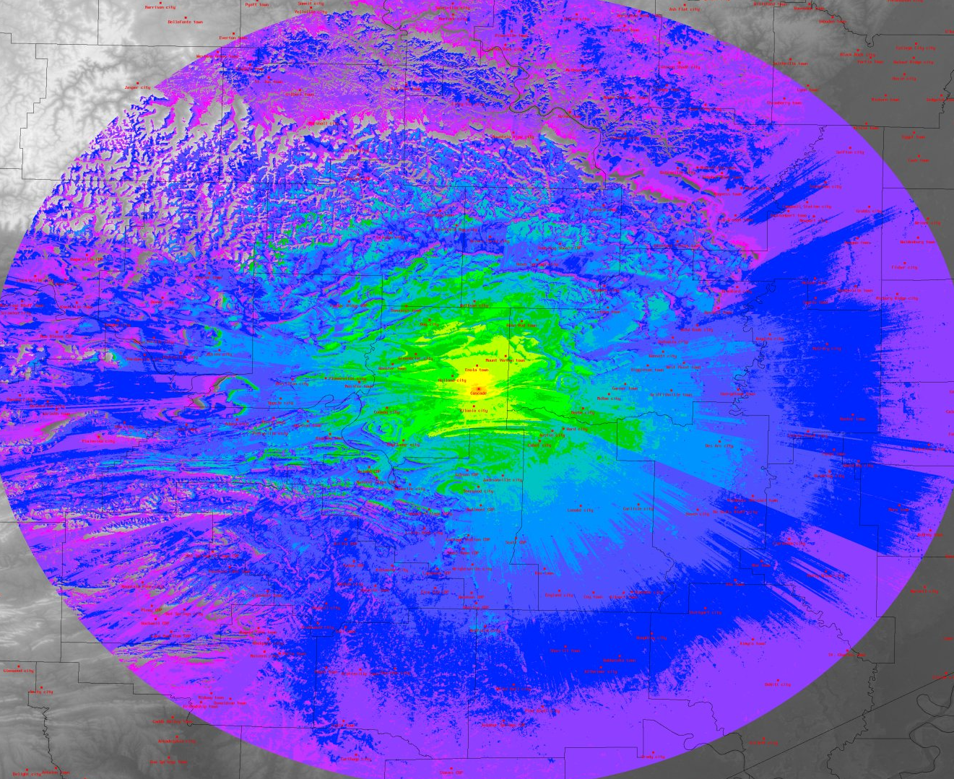
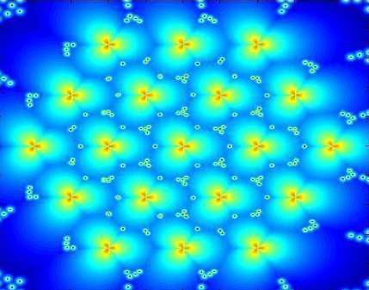
LTE ≠ LMR
Notes:
Key differences:
Data Network, Mission critical voice will remain on LMR . While LTE might evolve to allow for mission critical voice, it currently isn’t the top priority of FirstNet – Data is…
Site Density, LTE technology requires a higher tower site density than LMR. The coverage ratio is roughly 1:5, but this can vary greatly depending on the location.
All Digital, IP packet based network, from device all the way through.
Standards Based, make devices cheaper, more commercially available, and more interoperable nationally and internationally. – BUT LTE standards will need to evolve to help meet public safety needs.

Slide 9
Applications Management
FirstNet Application Store
FirstNet will provide a place for applications developers to concentrate on the Public Safety market
Application Developers to be vetted
Applications to be tested for security flaws, bandwidth inefficiencies, etc.

Slide 10
BYOD
It will be possible for Personally-Owned Devices to be used on the FirstNet network.
Individual users will NOT be able to acquire FirstNet service on their own.
Users may lose some control over their Personally-Owned Devices when on FirstNet
Security is a huge concern

Slide 11
Interoperability
Similar to cellular networks today, phone calls and data can be sent between various carrier networks
Networks are “Manufacturer-Agnostic”
Something to think about: Do we need to designate common apps that everyone should have on their device?

Slide 12

FirstNet
And
NG-911

Slide 13
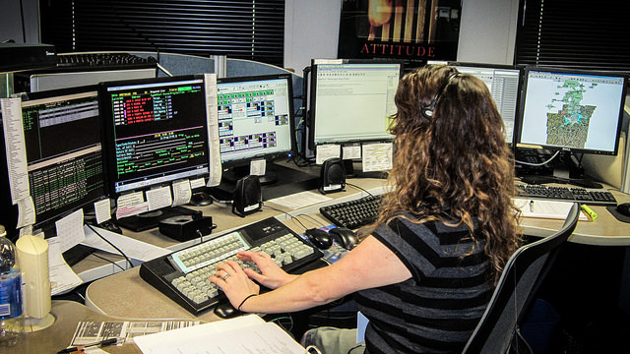
FirstNet & NG-911
Two Parallel Technology Projects
FirstNet
First Responders
NG-911
Our Citizens.
How will new technology affect your:
Field Operations
Dispatch Centers
Notes:
FirstNet and NG911 are going to radically transform Public Safety in the near future.. This will require us to rethink how we operate.

Slide 14
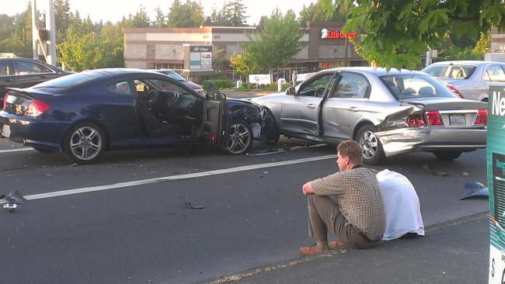
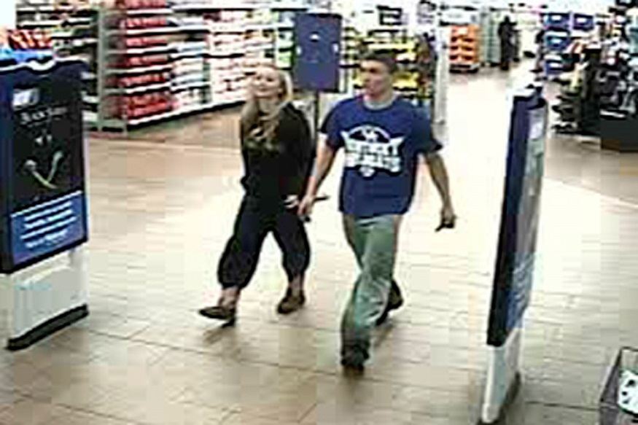

FirstNet & NG-911
Text to 911
Who, What, When?
Who Decides?
Notes:
FirstNet and NG911 are going to radically transform Public Safety in the near future.. This will require us to rethink how we operate.

Slide 15
Decisions
Decision
Do what’s best for your Agency
Cost
Coverage
Demo Devices
Features

Slide 16
For More Information:
www.firstnet.gov
Nationwide Information

Slide 17
Questions? Please Contact:
The Illinois Public Safety Communications Office:
217-531-0499
ljbell@ileas.org
Joe Galvin
IL FirstNet Program Lead & SWIC
Bill Springer
IL FirstNet Project System Architect
Bob Evans
Program Admin / Grant Compliance
Lori Bell
IL FirstNet Grant & Logistics

