Slide 1


ECOSYSTEM

Slide 2

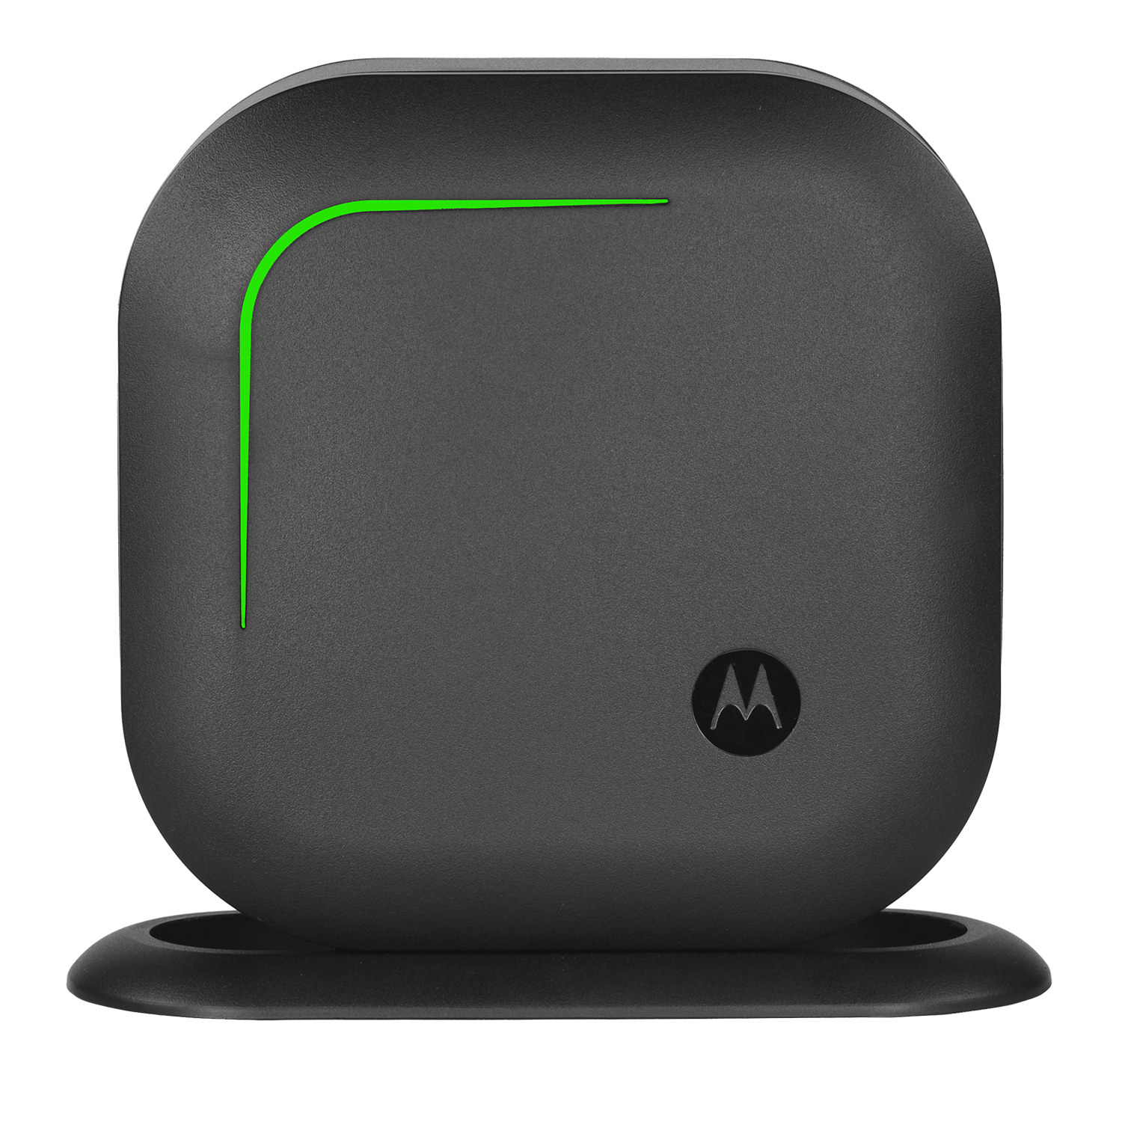

STAY
DISCREET
CONNECTED
SAFE
COMMUNICATION SOLUTION FOR DIRECT CONNECTION AND RAPID RESPONSE.
Motorola Solutions Confidential—Do Not Redistribute—PartnerEmpower Member Use Only.

Slide 3

OVERVIEW
The Curve Ecosystem is a combination of technologies that work together to enrich the customer experience. Enhancements like Voice Assist and Customer Assist embolden the Digital Hub and Wi-Fi Call Buttons to connect customers directly to staff; the Curve Digital Hub acting as an interface that connects your Wi-Fi Call Buttons to your Curve, DLR and DTR radios via voice alerts. With scalable opportunities like data analytics, this ecosystem is a tool for educated staffing, efficient operational workflows and real-time loss prevention.
Key Features:
Digital Hub is compatible with Curve, DLR and DTR radios
Call Buttons come in 4 flexible form factors
Call Buttons have attention-grabbing LED lights
Programmable escalation rule
Motorola Solutions Confidential—Do Not Redistribute—PartnerEmpower Member Use Only.
Notes:
First of a kind using cloud, WiFi with AI based voice assistant feature

Slide 4
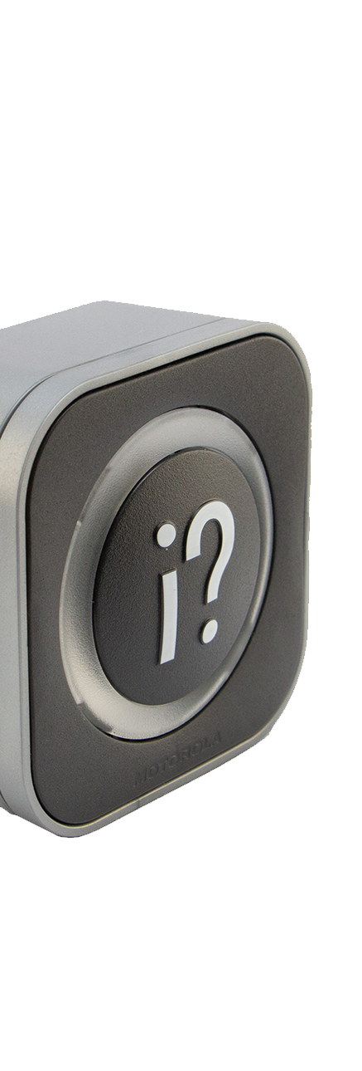
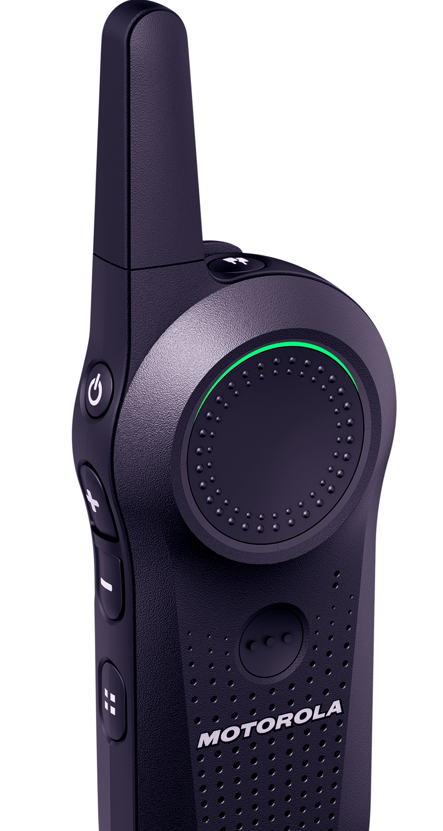
CUSTOMER & STAFF FRIENDLY
REMOTE CONFIGURATION
Wi-Fi CALL BUTTONS CONNECT TO RADIOS VIA DIGITAL HUB
CURVE PORTAL
Wi-Fi
LMR
EXTENDED RANGE
COLOR LED STATUS INDICATOR
SINGLE-BUTTON OPERATION
LED STATUS INDICATOR
Wi-Fi BASED, 4 DIFFERENT FORM FACTORS
COMPATIBLE WITH CURVE, DLR & DTR RADIOS
ASSURANCE LED AND MESSAGE WHEN SHOPPER PRESSES HELP
PROGRAMMABLE ESCALATION RULE
CONTINUED SUPPORT, BETTER OWNERSHIP EXPERIENCE:: Device name, model number and preview image clearly labeled on the box. Scan the QR code on the back of the device to find the Get Started page and support materials.
Motorola Solutions Confidential—Do Not Redistribute—PartnerEmpower Member Use Only.

Slide 5
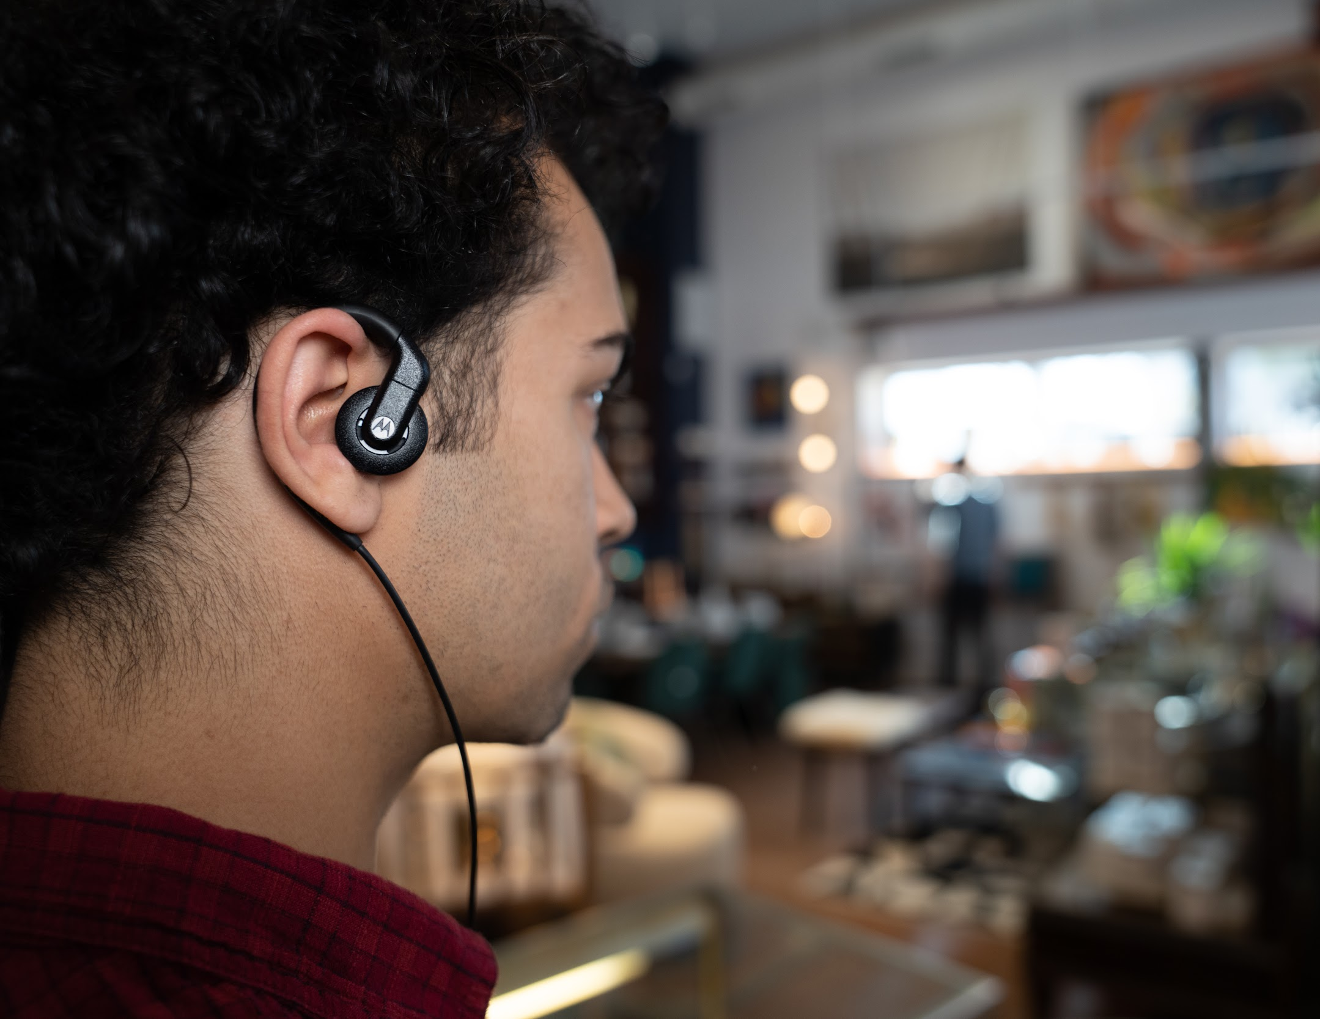

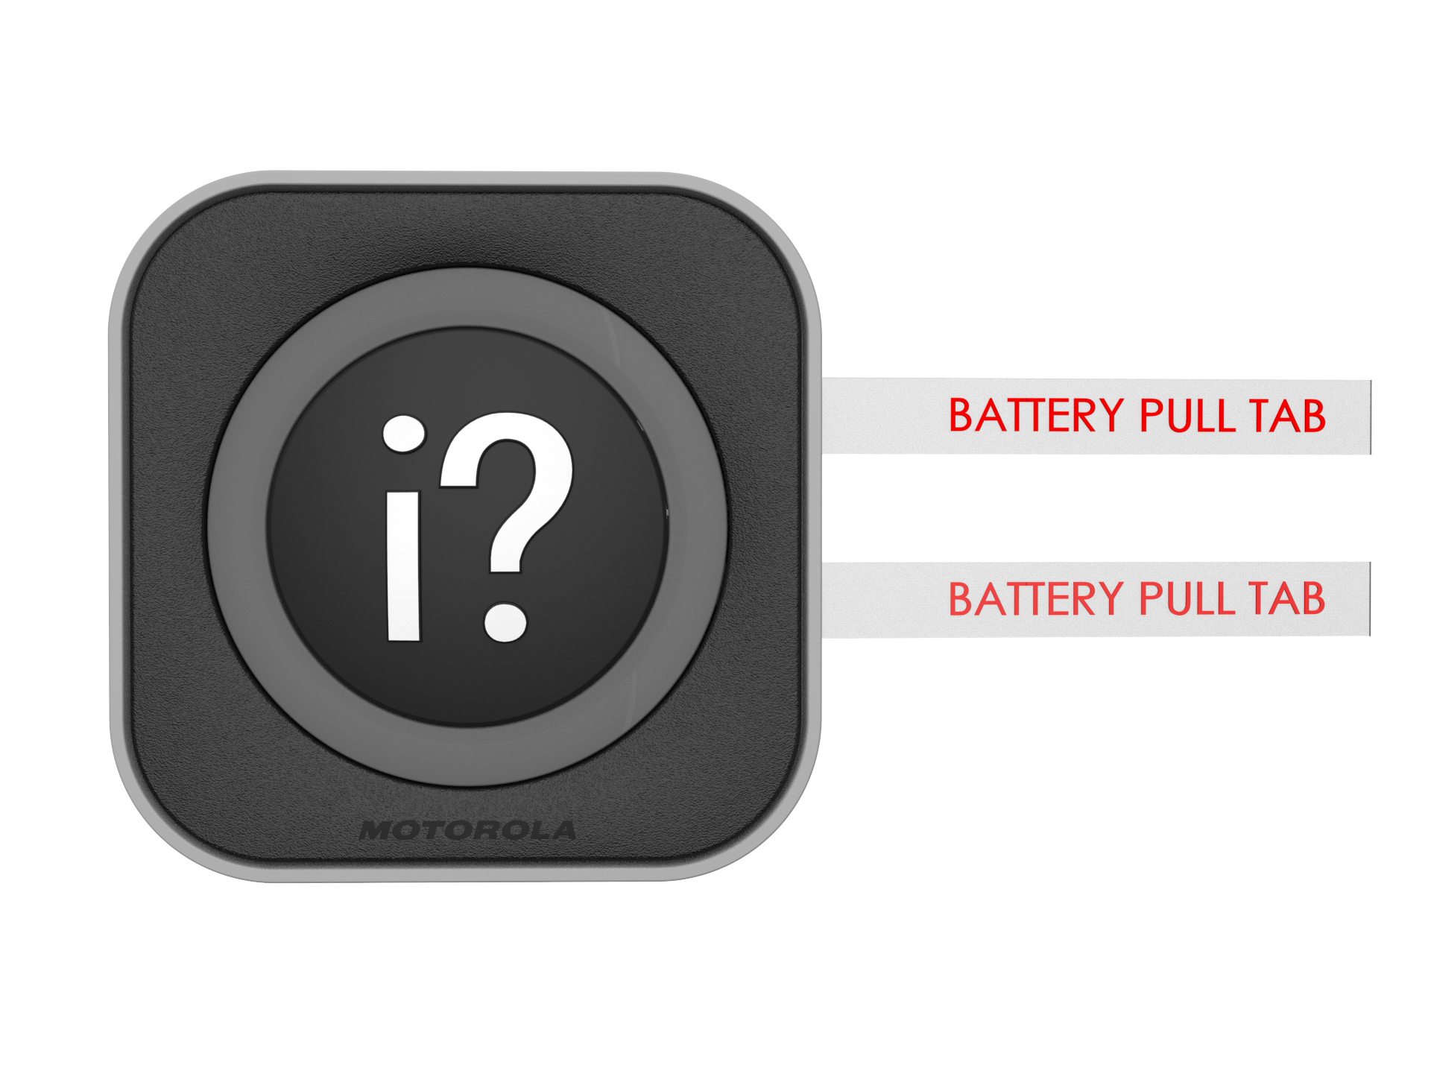
DESIGNED TO FIT INSIDE YOUR
WORKFLOW
Customer presses Wi-Fi call button for assistance
Curve Digital Hub sends configurable voice alerts to Curve, DLR or DTR radio fleet
With 3 years of battery life, over the air provisioning and reporting analytics, this solution is a model designed for recurring revenue.
Staff responds rapidly, ensuring customer is assisted and safe.
Motorola Solutions Confidential—Do Not Redistribute—PartnerEmpower Member Use Only.

Slide 6

KEY SPECIFICATIONS - WI-FI CALL BUTTON
MODEL | CB401: Glass mount Wi-Fi call button CB402: Blade style Wi-Fi call button (without blade) CB403C: Countertop mount Wi-Fi call button CB403W: Wall mount Wi-Fi call button
FREQUENCY BAND | 2.4GHz + 5GHz Wi-Fi
PACKAGING | White box
WARRANTY | 1 year
Wi-Fi STANDARDS SUPPORTED | 802.11a, g
REGULATORY | FCC part 15 and ISED RSS-247
BATTERY LIFE | 2 - 3 years*
* *Based on 6-10 button presses per day
Motorola Solutions Confidential—Do Not Redistribute—PartnerEmpower Member Use Only.
Notes:
Weight
With BT90 battery and battery door
145g
5.11 oz
With BT110 battery and battery door
155g
5.45 oz
Channels: Curve has the most channels of any other retail radio that we’ve developed.
Frequency: These frequencies create increased clarity and privacy enhancements while maintaining a license-free status

Slide 7
KEY SPECIFICATIONS - DIGITAL HUB
MODEL | DH300 Curve Digital Hub
FREQUENCY BAND | FCC license-free: 902 - 928 MHz
CHANNELS | 10
RANGE | Up to 300,000 sq ft
PACKAGING | White box
WARRANTY | 1 year
* *Based on 6-10 button presses per day
Motorola Solutions Confidential—Do Not Redistribute—PartnerEmpower Member Use Only.
Notes:
Weight
With BT90 battery and battery door
145g
5.11 oz
With BT110 battery and battery door
155g
5.45 oz
Channels: Curve has the most channels of any other retail radio that we’ve developed.
Frequency: These frequencies create increased clarity and privacy enhancements while maintaining a license-free status

Slide 8




ECOSYSTEM
Need technical support for your Curve Digital Hub or CB Wi-Fi Call Buttons?
Contact 1-800-448-6686 and select #1 for assistance.
MOTOROLA, MOTO, MOTOROLA SOLUTIONS and the Stylized M Logo are trademarks or registered trademarks of Motorola Trademark Holdings, LLC and are used under license. All other trademarks are the property of their respective owners. ©2021 Motorola Solutions, Inc. All rights reserved.
Motorola Solutions Confidential—Do Not Redistribute—PartnerEmpower Member Use Only.

